Slide 1
Variability
GrowingKnowing.com © 2020

Slide 2
Variability
We often want to know the variability of data.
Please give me $1000, I will give you…
  8% to 9% in a year. Small variability.
  -50% to 300% in a week. Large variability.
Most people prefer certainty to variability.
  We won’t meet in this classroom next week, and I am not certain where we will meet? Sound good? Everyone happy?
Business people consider variability a risk.
Business people like to avoid risks.
We can measure variability using range, variance, standard deviation, and coefficient of variation.

Slide 3
Range
The range is the largest number minus the smallest.
What is the Range of 1, 3, 4 and 9?
  Range = 9 – 1 = 8
The range is fast and easy but a crude measure
  We don’t know if most or a few data items are variable.
The common mistake in range is going to fast and missing the actual smallest or largest number.

Slide 4
Excel
Excel does not have an =RANGE function.
  TIP: if you do a search in Excel Help files you will find lots of references to range because Excel uses the term often in a non-statistical way to refer to a group of cells.
Use two functions
  =MAX to find the largest number
  =MIN for the smallest number
  Subtract =max from =min to get the range.
  Example: =MAX(a1:a9)-MIN(a1:a9)

Slide 5
Variance
Variance subtracts every data item from the mean
Variance is a better measure of variability than range because you look at every data item rather than just 2 data items.
Variance is not easy to understand as the measure is units squared.
  For example, if your data measures how long a job takes in seconds, variance will be seconds squared (seconds²).
  Most people cannot understand or visualize a squared second.
Variance is important because variance is used to calculate the standard deviation which is a very useful measure.

Slide 6


Formula
Sample variance:
Population variance:
Σ is called "Sigma" (upper case) and requires you sum the data values.
x_{i} represents each data value.
x̄ is pronounced "x bar" and it represents a sample mean.
μ is called "mu" and it represents a population mean.
n is the count of the number of data values in a set of sample data.
N is the count of the number of data values in a population data set.
Note: Sample and population formulas are different!

Slide 7
Excel
=VAR.S(a1:a5) for a sample
=VAR.P(a1:a5) for a population
To use the correct formula, you must know,
  are you are working with a sample or population?

Slide 8
Manual Calculation
What is the variance of 1, 2, 3 days?
1) Calculate the mean: =(1+2+3) / n = 6 /3 = 2
2)Data x_{i} - x̄ (x_{i} - x̄)²
1 1 - 2 = -1 1
2 2 - 2 = 0 0
3 3 - 2 = +1 1
Totals: 0 2
Variance = 2 / (3-1) = 1 days²

Slide 9
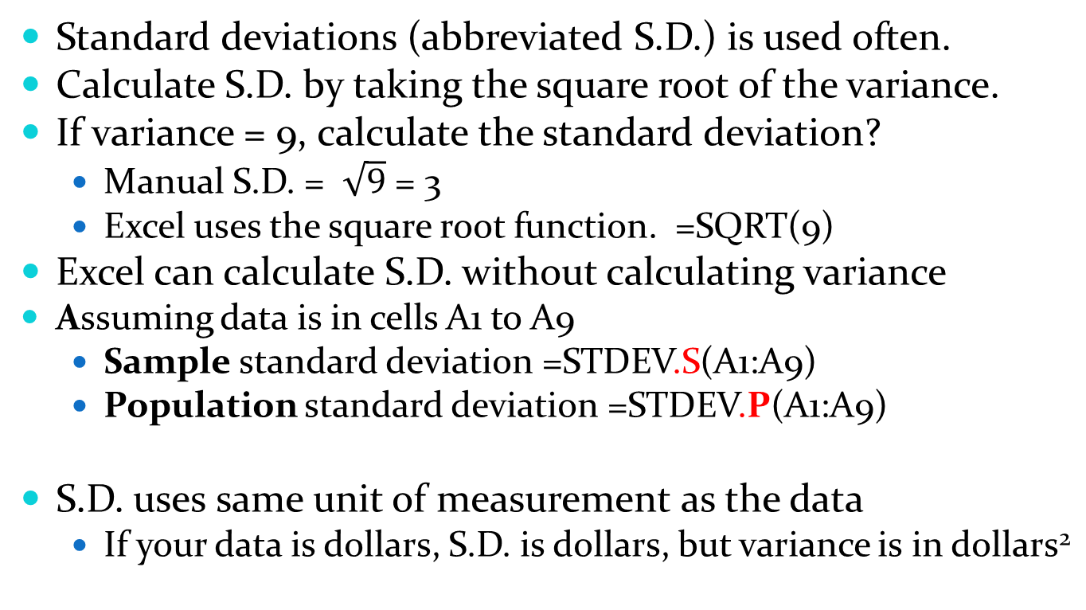
Standard deviation
Standard deviations (abbreviated S.D.) is used often.
Calculate S.D. by taking the square root of the variance.
If variance = 9, calculate the standard deviation?
  Manual S.D. = $\sqrt{9}$ = 3
  Excel uses the square root function. =SQRT(9)
Excel can calculate S.D. without calculating variance
  Assuming data is in cells A1 to A9
  Sample standard deviation =STDEV.S(A1:A9)
  Population standard deviation =STDEV.P(A1:A9)
S.D. uses same unit of measurement as the data
  If your data is dollars, S.D. is dollars, but variance is in dollars²

Slide 10
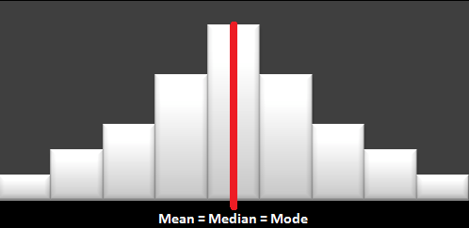
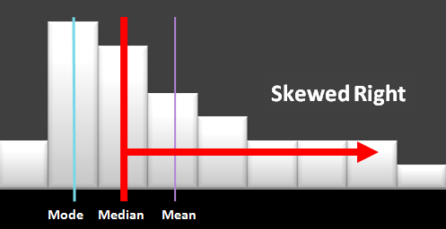
Skewed
When you chart your data is the data symmetrical, or lopsided to the right or left?
A skew value of zero indicates symmetrical
Notice the long tail on the skewed diagram
Symmetrical
Skewed right

Slide 11

Formula
There is more than one formula for skewness.
  The above formula is used for the test questions on our website.
Excel has a function called =SKEW(a1:a9)
  Excel uses a different formula than the one above.
  Check with your teacher to see what method is preferred.

Slide 12
Skew questions
The question may provide raw data,
  if so, calculate the mean, median, and standard deviation and use the results to find skewness
The question may give you the mean, median, and standard deviation, so 3 fewer calculations are needed.
A popular test question asks if data is skewed right or left by comparing the mean, median, and mode.
  If the mean, median, or mode are approximately equal then the data is symmetrical
  If the data is skewed, the mean will be pulled towards the long tail since the mean is easily influenced by extreme values
    If the mean is larger than the median, data is skewed right
    If mean is smaller than the median, data is skewed left

Slide 13
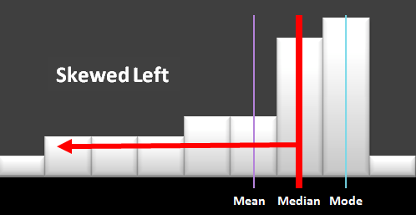
Calculate if the data is skewed for these numbers:
  1, 2, 3, 4, 5, 9, 23, -5, and -39.
In Excel:
  =3*(AVERAGE(a1:a9)-MEDIAN(a1:a9))/STDEV.S(a1:a9)
    = -0.4813
This example is skewed to the left.

Slide 14
Empirical Rule
Many books are about six sigma; a concept using the empirical rule.
  Six sigma is popular in business to set quality objectives
If your data is normally distributed, the empirical rule states (S.D. is abbreviated for standard deviation)
  68% of the data will fall between 1 S.D. from the mean
  95% of the data will fall between 2 S.D. from the mean
  99.7% of the data will fall between 3 S.D. from the mean
We recommend you memorize the values: .68, .95, or .997
The symbol for S.D. is sigma, so 3 S.D. above the mean plus 3 S.D. below the mean adds to 6 sigma
  99.7% of work must meet quality objectives to be six sigma
Is six sigma quality good enough?

Slide 15
Calculate the empirical rule
There are 2 types of questions
  You are given the probability and asked for the data interval
  You are given the data interval and asked for the probability

Slide 16
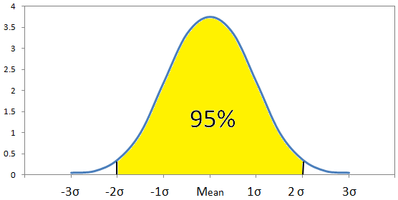
Probability given: With a mean of 600, and S.D. of 10, what is the interval needed to hold 95% of the data?
  95% is 2 S.D. above and below the mean (memorized)
    Upper value is 600+10+10 = 620
    Lower value is 600-10-10 = 580
    Answer is 580 to 620

Slide 17
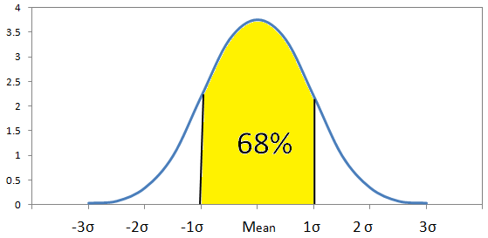
With a mean of 20, standard deviation of 2, and interval of 18 to 22, what is the probability data lies in this interval?
  22 is 1 S.D. above the mean, 18 is 1 S.D. below
  Answer = .68 because we memorized it 1 S.D. is 68%.

Slide 18
Chebyshev
Empirical rule is for data that is normally distributed.
Chebyshev is for data NOT normally distributed.
Formula
Percent of data = 1 – 1/standard deviation²
The questions are similar to the empirical rule

Slide 19
For data that is NOT normally distributed, what is the probability data will fall within 2 standard deviations of the mean?
  Probability = 1 – 1/2² = 1 – ¼ = 75%
  Answer: 75% of data will fall within 2 standard deviations of the mean.
Using Chebyshev, what is the interval and percentage of data that will fall within 3 standard deviations if the mean is 100 and standard deviation is 10.
  For 3 standard deviations, mean +/- 3 x S.D.
    Upper interval = 100 +30 =130
    Lower interval = 100 -30 = 70
  Percent = 1 – 1/3² = 1 – 1/9 = .89
  There is 89% probability data will fall within 3 std deviations.

Slide 20
Coefficient of Variation
Is standard deviation (S.D) of 100 large variability?
  We are not sure until we know the size of the mean
    Mean = 200, then S.D. = 100 is very large
    Mean = 10 million then variability of S.D. = 100 is small
  How do we compare variability if one variable measures payment by the hour and another measures payment by commission in dollars?
We can compare using Coefficient of Variation
Formula: Coefficient Variation = (S.D/ Mean) x 100

Slide 21
Coefficient of Variation Example
Teacher A grades students finding a mean of 80 with standard deviation of 10. Teacher B grades students finds a mean of 1000 and standard deviation of 50. Which teacher has more consistent results?
Step 1: CV Teacher A = 10 / 80 × 100% = 12.5%
Step 2: CV Teacher B = 50 / 1000 × 100% = 5%
Step 3: Teacher B has more consistent student results. Teacher A has more variability.

Slide 22
The end
of the beginning
or the beginning of the end, if you have not been practising enough problems
Keep practising questions is the key to success.
End when you can get 3 questions right in a row at the hardest difficulty level for every topic.
  Run the Progress report to see your completion results.

