Slide 1
Proportion
Excel
GrowingKnowing.com © 2020

Slide 2


Sample proportions
Standard error for proportion =
z score =
  p_{s} is sample proportion.
  p is population proportion.
  σ_{p} is standard error
  n is the sample size.
To qualify to use the formula: np ≥ 5 and n(1-p) ≥ 5

Slide 3
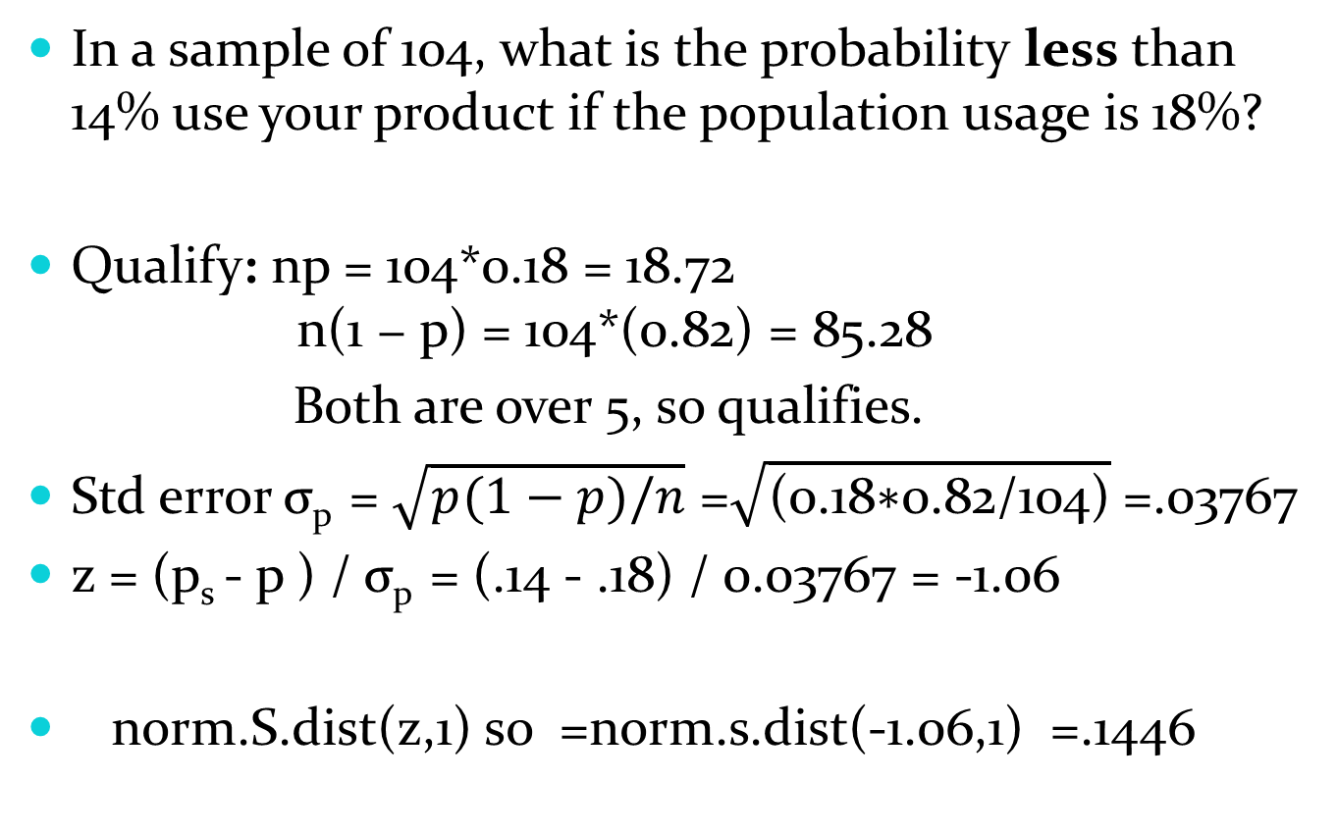
In a sample of 104, what is the probability less than 14% use your product if the population usage is 18%?
Qualify: np = 104*0.18 = 18.72
n(1 − p) = 104*(0.82) = 85.28
Both are over 5, so qualifies.
Std error σ_{p} = $\sqrt{p(1−p)/n}$ =$\sqrt{\text{(0.18∗0.82/104)}}$=.03767
z = (p_{s} - p ) / σ_{p} = (.14 - .18) / 0.03767 = -1.06
norm.S.dist(z,1) so =norm.s.dist(-1.06,1) =.1446

Slide 4
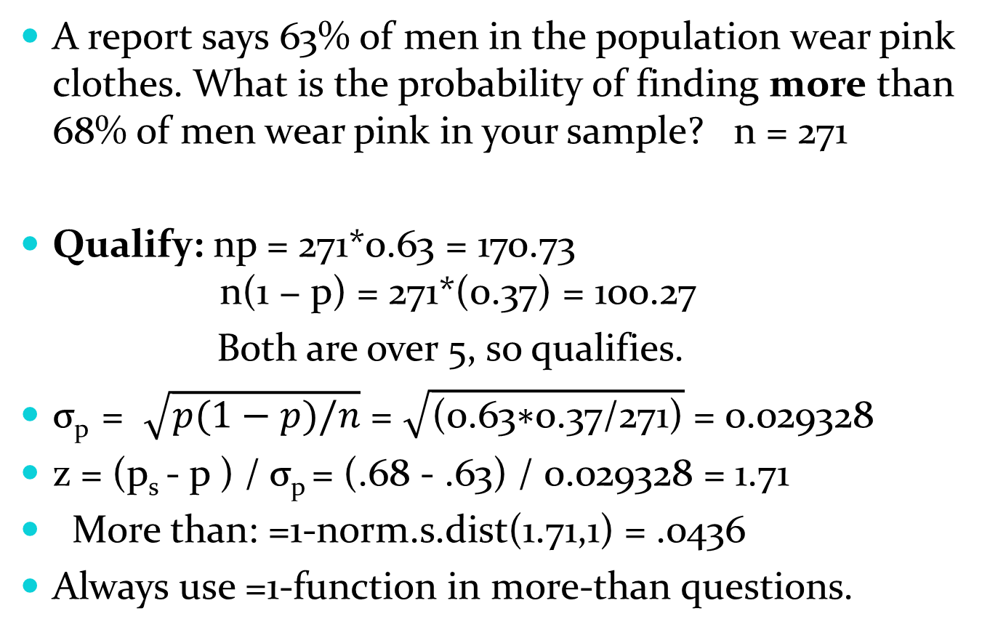
A report says 63% of men in the population wear pink clothes. What is the probability of finding more than 68% of men wear pink in your sample? n = 271
Qualify: np = 271*0.63 = 170.73
n(1 − p) = 271*(0.37) = 100.27
Both are over 5, so qualifies.
σ_{p} = $\sqrt{p(1−p)/n}$ = $\sqrt{\text{(0.}\text{63}\text{∗0.}\text{37}\text{/}\text{271}\text{)}}$= 0.029328
z = (p_{s} - p ) / σ_{p} = (.68 - .63) / 0.029328 = 1.71
More than: =1-norm.s.dist(1.71,1) = .0436
Always use =1-function in more-than questions.

Slide 5
Common error
Take care not to confuse the population proportion p with the sample proportion p_{s}
If one is labeled as population or sample, then you know both
  If p is given, then the other proportion must be p_{s} and visa-versa
If population and sample are not labelled, then the proportion that is assumed to be true is the p and the value you are testing against is p_{s}

Slide 6
Go to website, do sample proportion problems.

Slide 7
Confidence using Proportion

Slide 8
Proportion
We have shown Confidence Levels for Means
We also have Confidence Levels for Proportion
For proportion, the alpha, confidence levels, margin of error, and interval calculations are the same as Means.
The standard error for proportion uses a different formula than standard error for means.

Slide 9
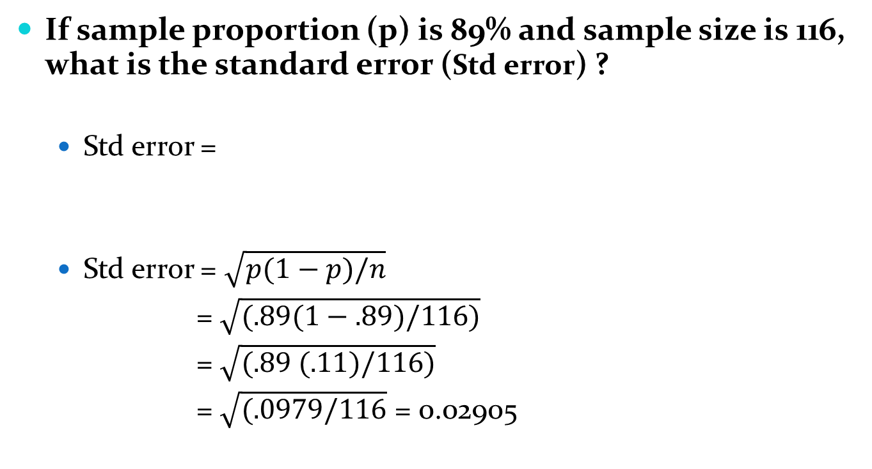
Test yourself
If sample proportion (p) is 89% and sample size is 116, what is the standard error (Std error) ?
  Std error =
  Std error = $\sqrt{p(1−p)/n}$
  = $\sqrt{(.89(1−.89)/116)}$
  = $\sqrt{(.89 (.11)/116)}$
  = $\sqrt{(.0979/116}$ = 0.02905

Slide 10
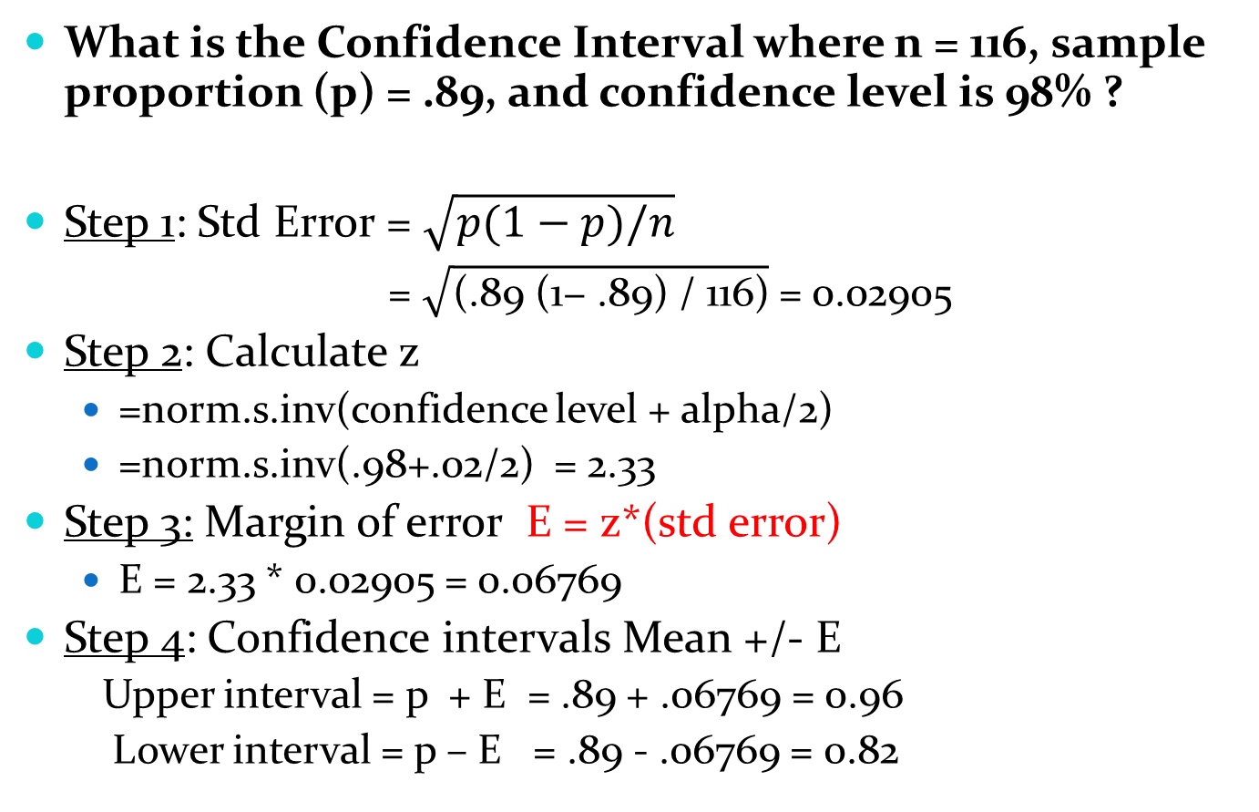
What is the Confidence Interval where n = 116, sample proportion (p) = .89, and confidence level is 98% ?
Step 1: Std Error = $\sqrt{p(1−p)/n}$
  = $\sqrt{\text{(.89 (1− .89) / 116)}}$= 0.02905
Step 2: Calculate z
  =norm.s.inv(confidence level + alpha/2)
  =norm.s.inv(.98+.02/2) = 2.33
Step 3: Margin of error E = z*(std error)
  E = 2.33 * 0.02905 = 0.06769
Step 4: Confidence intervals Mean +/- E
  Upper interval = p + E = .89 + .06769 = 0.96
  Lower interval = p – E = .89 - .06769 = 0.82

Slide 11
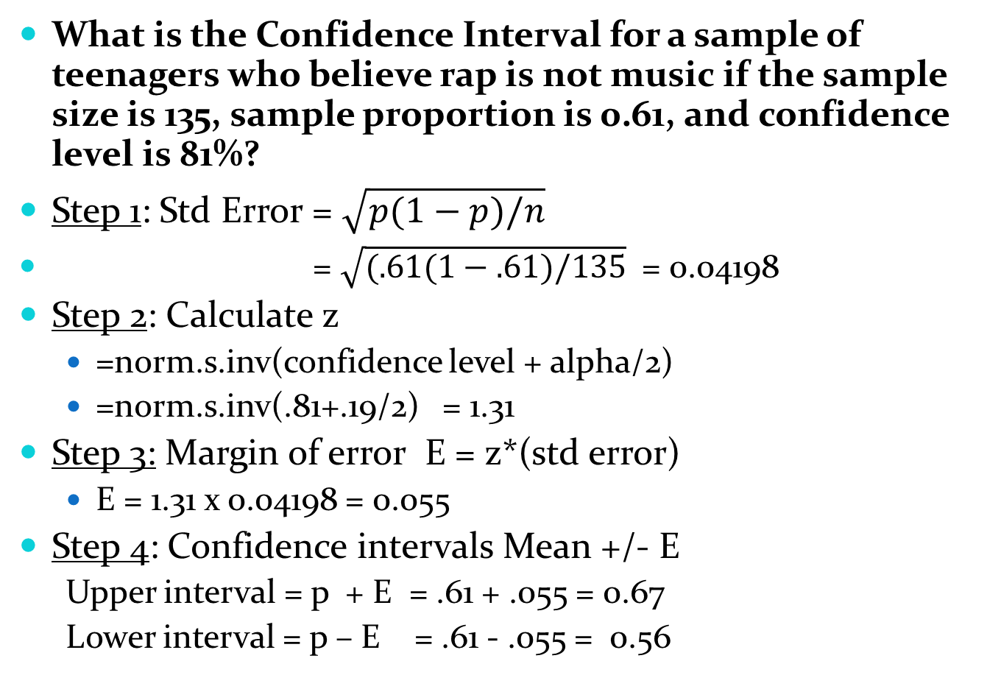
What is the Confidence Interval for a sample of teenagers who believe rap is not music if the sample size is 135, sample proportion is 0.61, and confidence level is 81%?
Step 1: Std Error = $\sqrt{p(1−p)/n}$
  = $\sqrt{(.61(1−.61)/135}$ = 0.04198
Step 2: Calculate z
  =norm.s.inv(confidence level + alpha/2)
  =norm.s.inv(.81+.19/2) = 1.31
Step 3: Margin of error E = z*(std error)
  E = 1.31 x 0.04198 = 0.055
Step 4: Confidence intervals Mean +/- E
  Upper interval = p + E = .61 + .055 = 0.67
  Lower interval = p – E = .61 - .055 = 0.56

Slide 12
Practice
Go to website and practice Confidence Interval
  Difficulty level 1 and 2

Slide 13
Sample size with proportion

Slide 14

.
You are studying the proportion of students who believe in a soul? What should Sample Size be if confidence level = 0.8, sample proportion = 0.46, and error rate = 0.11 ?
Formula =
z =norm.s.inv(confidence + alpha/2 )
= norm.s.inv(.80 + .20/2 ) = 1.28
n = 0.46*(1 − 0.46)*(1.28/0.11)^2
= 0.2484 × 11.636363642 = 33.63
Round up to 34

Slide 15
Go to website and practice sample size calculations

Slide 16
Hypothesis Proportion

Slide 17
Hypothesis Proportion
We have shown hypothesis testing of means, but you can do hypothesis testing with proportions as well.
  We still use the 5 steps of hypothesis testing
  Stating the hypothesis, the decision rule, and rejecting the null hypothesis do not change from Hypothesis Testing for Means
What changes is we use proportion formulas from confidence testing and proportion sampling.

Slide 18
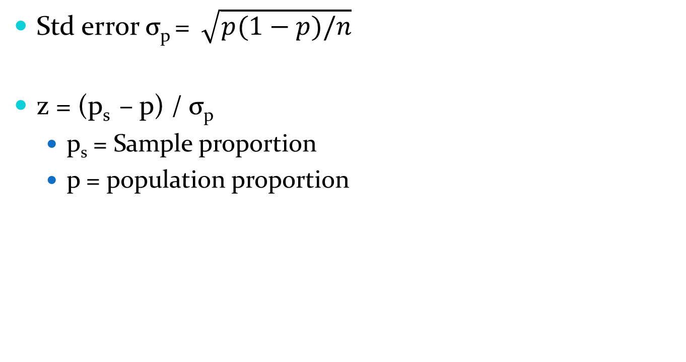
Formulas for proportion
Std error σ_{p} = $\sqrt{p(1−p)/n}$
z = (p_{s} – p) / σ_{p}
  p_{s} = Sample proportion
  p = population proportion

Slide 19
The claim is that 0.31 clients respond to sale items, and you want to prove it is less. Your survey of 182 clients showed 32 respond. Test the hypothesis at a 5 % level of significance.
Qualify
  Recall that to qualify to use our standard error calculation that
    np ≥ 5 and n(1-p) ≥ 5
    182*.31 = 56.42 and n*(1-p) = 125.58
    Both are over 5, so we qualify.
There are two ways we may be given proportion data
  Given proportion directly, for example 31% respond, or
  Given 32 out of 182 respond, we calculate proportion as 32/182 = .1758 so 17.58% respond.

Slide 20
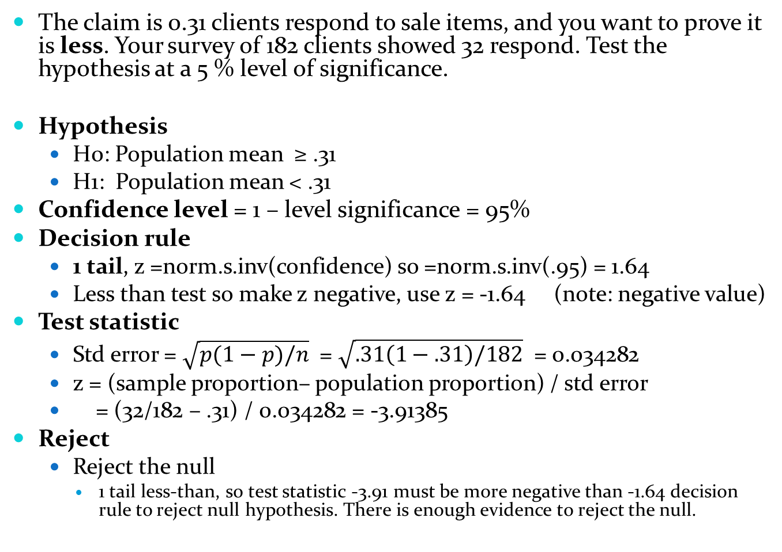
The claim is 0.31 clients respond to sale items, and you want to prove it is less. Your survey of 182 clients showed 32 respond. Test the hypothesis at a 5 % level of significance.
Hypothesis
  H0: Population mean ≥ .31
  H1: Population mean < .31
Confidence level = 1 – level significance = 95%
Decision rule
  1 tail, z =norm.s.inv(confidence) so =norm.s.inv(.95) = 1.64
  Less than test so make z negative, use z = -1.64 (note: negative value)
Test statistic
  Std error = $\sqrt{p(1−p)/n}$ = $\sqrt{.31\left(1−.31\right)/182}$ = 0.034282
  z = (sample proportion– population proportion) / std error
  = (32/182 – .31) / 0.034282 = -3.91385
Reject
  Reject the null
    1 tail less-than, so test statistic -3.91 must be more negative than -1.64 decision rule to reject null hypothesis. There is enough evidence to reject the null.

Slide 21

A marketing campaign claims 0.55 clients respond; you want to prove it is more. Your survey of 147 clients showed 110 respond. Test the hypothesis at a 5% level of significance.
Hypothesis
  H0: Population mean ≤ .55
  H1: Population mean > .55
Confidence level = 1 – level significance = 95%
Decision rule
  1 tail, z = norm.s.inv(confidence ) so =norm.s.inv(.95) = 1.64
  More than, so use z = +1.64
Test statistic
  Std error = $\sqrt{p(1−p)/n}$ = $\sqrt{.55\left(1−.55\right)/147}$ = 0.04103259
  z = (sample proportion– population proportion) / std error
  = (110/147 – .55) / 0.0410326 = 4.84
Reject
  Reject the null
    1 tail more-than, so test statistic 4.84 must be more positive than 1.64 decision rule to reject null hypothesis giving us sufficient evidence to reject the null.

Slide 22
Go to website, do hypothesis proportion questions

