Slide 1
Probability
GrowingKnowing.com © 2011

Slide 2
Probability
Probability methods are powerful ways to quantify uncertain outcomes.
  What is the probability I get a job in marketing?
  What is the probability I get married in China?
  What is the probability I make money buying stock in IBM?
You can calculate your chances.
  For example if there are more men than women in China, your chance of marriage depends on your gender.

Slide 3
Experiment: An experiment is made up of trials.
Trial: A trial results in one outcome.
Outcome: The result of a probability test. For example, two coin tosses can have four possible outcomes: HH, HT, TH, TT
Sample space: Sample space is a list of all the different outcomes possible. The sample space is usually listed within curly brackets.
  Sample space for even numbers between 1 and 5 is {2,4}.
Event: An event is combination of outcomes that are a subset of the sample space.
  Example, an event where 1 coin toss is heads and 1 is tails
    {HT, TH}

Slide 4
Tree diagrams
Tree Diagrams can make probabilities easier to follow.
What’s the probability a family has 2 sons if the probability of a boy is 50%.
-Probability of Boy-Boy =.25
-Probability of Boy-Girl or Girl-Boy is .25+.25 = .5
-Probability of Girl-Girl = .25
1/2
Boy
.5 x .5 = .25
Boy
Girl
.25
1/2
Boy
.25
Girl
Girl
.25

Slide 5
Examples
Gender | Movies | Dinner | Total
Male | 10 | 30 | 40
Female | 25 | 20 | 45
Total | 35 | 50 | 85
This table shows survey results by gender when students were asked if they preferred going to dinner or movies.
We will use this contingency table to demonstrate probability calculations.

Slide 6
Marginal probability
What is the probability if you randomly pick a student you would pick a Male?
  P(Male) = 40 / 85 = 0.47
What is the probability you would randomly pick someone who prefers dinner (use 2 decimal places)
  P(Dinner) = 50 / 85 = 0.59
You calculate marginal probabilities by dividing the count of desired outcomes by total outcomes.
Gender | Movies | Dinner | Total
Male | 10 | 30 | 40
Female | 25 | 20 | 45
Total | 35 | 50 | 85

Slide 7
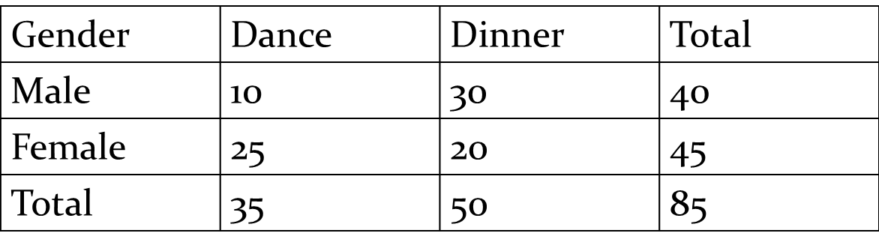
Complement
What is the probability you randomly pick a student who is NOT Male?
  P(~Male) = 1 - 40/85 = 1 - .47 = .53
  You subtract the probability of a Male from 1 and get the probability you pick someone who is not male.
  This is a trivial example to show the idea. Complement calculations can be a shortcut in some complex questions.

Slide 8
Basic idea
With probability, the answer is always between 0 and 1.
  A probability of 0 means no chance.
  A probability of 1 means it is a certainty.
Marginal
  Probability of event A shown as P(A)
  P(A) = desired outcome / Total number outcomes
Complement
  Probability event A does NOT happen shown as P(~A)
  P(~A) = 1 – (A)

Slide 9
Union and Intersection
You can be asked to combine probabilities.
Union. What is the probability of A or B?
Intersection. What is the probability of A and B?
  Mutually exclusive: 2 outcomes cannot occur together
Which events are mutually exclusive?
  I am in New York or Toronto.
    Mutually exclusive, you cannot be in both places at same time.
  I am wearing a belt or glasses.
    Not mutually exclusive. You can wear both together

Slide 10
Gender | Movies | Dinner | Total
Male | 10 | 30 | 40
Female | 25 | 20 | 45
Total | 35 | 50 | 85
Union
What is the probability you randomly pick a student who is Male or Female?
  Formula: Union = P(A) + P(B) – P(Both)
    Called the Addition Rule
  Mutually exclusive. You are male or you are not.
    If mutually exclusive, the probability of both is zero.
  P(Male or Female) = 40/85 + 45/85 – 0 = 85/85 = 1.0

Slide 11
Union
What is the probability you randomly pick a student who is Female or prefers movies?
  Union = P(A) + P(B) – P(Both)
  Not Mutually exclusive. You can be female and enjoy movies at the same time.
  P(Female or Movies) = 45/85 + 35/85 -25/85 = 55/85 or .65
    25 females were counted twice: counted as females and counted again for movies, so you subtract 25 to adjust for double counting
Gender | Movies | Dinner | Total
Male | 10 | 30 | 40
Female | 25 | 20 | 45
Total | 35 | 50 | 85

Slide 12
Intersection
What is the probability you randomly pick a student who is Female And prefers movies?
  Easy method: Draw a line to see where 2 groups cross
    P(Female and Movies) lines cross at 25
  P(Female AND Movies) = 25 / 85 or .29
What P(Dinner AND Movies) = lines don’t cross so 0/85
Gender | Movies | Dinner | Total
Male | 10 | 30 | 40
Female | 25 | 20 | 45
Total | 35 | 50 | 85

Slide 13
Gender | Movies | Dinner | Total
Male | 10 | 30 | 40
Female | 25 | 20 | 45
Total | 35 | 50 | 85
Conditional
Given you pick a movie person, what is the probability they are male?
  Conditional questions restrict choices to just the group selected
    only movies is our condition so we divide by 35
    Conditionals are the only type of question where the bottom number changes.
      We use 35 movie people rather than 85 students used in other problems.
  P ( Male | Movie) = 10/35 or .286
    We have only 10 males if we restrict to the condition of only the movie people.
    The symbol | represents the word given.

Slide 14
Conditional
No matter how the question is phrased, start with the conditional
  Given you pick a male, what is the probability he prefers dinner
  What is the probability a student prefers dinner given you picked a male?
  Given is males in both questions, so bottom number is 40.
  P(Dinner | Male) = 30/40 = .75
Gender | Movies | Dinner | Total
Male | 10 | 30 | 40
Female | 25 | 20 | 45
Total | 35 | 50 | 85

Slide 15
Gender/ Date preference | Movie | Dinner
Male | 10 | 30
Female | 25 | 20
Totals
40
45
Totals | 35 | 50 | 85
What is the probability you randomly select a female?
  Why are you finding this question harder?
The question is harder because the table did not provide the totals.
  You need to take the table and add the totals as shown in previous slides.

Slide 16
The questions can be harder by expanding the 2x2 contingency table into 2x3, or 3x2, or 3x3.
The probability questions are the same, but you have more data to consider.
What is the probability you pick someone who does NOT want to go to z00? Round to 2 decimal places
  =1 – 35/110 = 65/110 = .68
  As you get more data, the complement is more useful.
 | Movie | Dinner | Zoo | Total
Male | 15 | 10 | 25 | 50
Female | 30 | 20 | 10 | 60
Total | 45 | 30 | 35 | 110

Slide 17
What’s the probability you randomly pick someone who prefers the zoo?
  35/110
What is the probability for P(Male | Movie) ?
  45 movie people of which 15 are male. = 15/45
What is the probability randomly pick a female AND she prefers zoo?
  = 10/110
What is the probability randomly pick a female OR someone who prefers zoo?
  = 60 + 35 – 10 = 85/110
 | Movie | Dinner | Zoo | Total
Male | 15 | 10 | 25 | 50
Female | 30 | 20 | 10 | 60
Total | 45 | 30 | 35 | 110

Slide 18
Replacement
If I have 10 red cars and 5 blue cars, what is the probability I randomly pick a blue car for a friend?
  5/15
Now what’s probability I randomly pick a blue car for myself?
  4/14
  Remember, I gave a car to my friend, so I have 14 cars not 15, and 4 blue cars instead of 5.
You must ask if there is Replacement?
  After picking a car for my friend, did she return the car to me (replacement), or did she keep it?

Slide 19
Independence
Independence is two outcomes, and the first outcome does not impact the probability of the second outcome.
If number 7 on the 6/49 has won every time for a long time, does the number 7 have more probability for selection on the next lottery?
  Some say 7 is lucky because it keeps winning, so pick 7
  Some say 7 probability is low to win again, pick another number.
  Who is right?
    7 does not know how many times it won
    In a fair game , each number has the same chance of selection.
    A lottery should be independent, the last draw has no impact on the next draw. Any number can win. Why?
    Because of replacement. Every number that won is replaced for the next draw, so each number has the same probability of selection: 1/49.

Slide 20
Easy way to calculate Independence
If P(A) x P(B) = P(A and B), then it is independent
Randomly select a survey: is the probability of selecting someone who bought a product independent of the item being on discount?
P (Bought) = 21 / 50 P(Discount) = 14/50
P(A) x P(B) = (21 x 14)/ (50 x 50) = 294/2500 = .1176 = .12
P(Bought and Discount) = 12/50 = .28
Since .12 is not equal to .28, buying and discounts are not independent.
Buying a product and discounts are dependent.
 | Not Bought | Bought | Totals
No discount | 27 | 9 | 36
Discount | 2 | 12 | 14
Total | 29 | 21 | 50

Slide 21
Common errors
When you get an OR question, is it mutually exclusive?
  If you can have both OR conditions at the same time, you need to subtract for double counting.
In a conditional probability, remember the denominator (number at bottom of the fraction) is restricted to just the conditional group.

Slide 22
Saving your life with statistics
Your doctor says your test for cancer is positive.
You ask the doctor how accurate the test is, and he answers 90% indicating the result is not a mistake.
  So is the probability 90% that you have cancer?
What do you do next?
  Spend all my money having fun now.
  Quit my job and tell my boss what I really think.
  Get a second opinion
  All of the above
  The correct answer is C.

Slide 23
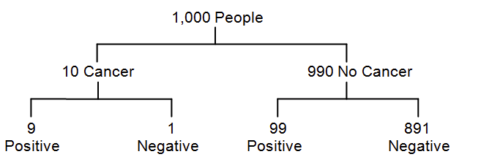
If a test is 90% accurate, then 90% of people who have a disease will test positive
  Take a population of 1000 and assume 10 have cancer.
  90% accurate test will correctly show 9 of the 10 have cancer
False negative: 1 person with cancer is told incorrectly they are healthy because the test is 90% accurate it misses 1 in 10 cancer victims.
A large number of people do not have cancer (990 of 1000).
False positive: 99 out of 990 are told they have cancer incorrectly because the test is 90% accurate.

Slide 24
Given you get a positive result on a test, if the test is 90% accurate, what is the probability you have cancer?
  Most people say 90%.
This is a conditional probability.
  99 + 9 = 108 got a positive test result.
  Out of the 108 positive results, 9 had cancer.
P (Cancer | Positive) = 9/108 = 8%
Tell your doctor you want to be retested, because as a probability expert you know tests that are 90% accurate can give correct positive results in 8% people. Why?

Slide 25
Multiplication
My wife opens the wardrobe and says, “I have nothing to wear”.
How many outfits does she have if I count 30 pairs of shoes, 40 blouses, and 35 skirts?
We can count the number of possible arrangements by multiplication
  30 x 40 x 35 = 42,000 different outfits.

Slide 26
Permutation and Combination
Combinations and permutations show how many ways you can form a small group from a larger group without repetition.
Using the 26 letters in the alphabet, how many passwords could you make using just 2 letters if you do not repeat any letter twice? (eg. AB is okay, AA is not)
If you have a lottery and must guess 6 numbers correctly out of a possible 49 without repeating any number, what is your probability of winning?
  If it was 7/49 instead of 6/49, how does that change your chance of winning the lottery?

Slide 27
What is the difference between multiplication, combination, and permutation?
  Permutations care about order,
  Combinations do not care about order.
  Multiplication uses multiple groups (skirts and shoes), but permutation/combination has one group (winning lottery numbers, team of friends)
Permutations
  Does it matter if I lick your ice cream before you?
    Then order matters. Permutation.
  Your password is AB. If you type BA, it won’t work. Order matters.
Combinations
  If you have the correct 6 numbers for a 6/49 lottery, you win.
    No-one checks for the order you picked your numbers.
    Order does not matter so 6/49 lottery is a combination.
  If you pick 2 friends from 6 to see a movie, does order matter?
    No. John and Mary, or Mary and John, is the same group.

Slide 28


Formula
Permutation:
Combination:
n is the count of data values,
r is the smaller group selected from n
n! is a factorial.
  3! = 3 x 2 x 1. 5! = 5 x 4 x 3 x 2 x 1. Note: 0! = 1.

Slide 29
How to calculate?
Excel function: =PERMUT(n,r)
=COMBIN(n,r)
Put the big number first or you get error #NUM.
=Permut is in the statistical function group on Excel
=Combin is in the Math and Trig function group.
  If you can’t find a function, select All as function group.
Manual: Most calculators have button nCr for combinations and nPr for permutations.

Slide 30
Examples
Using 26 letters in the alphabet without repeating a letter, how many passwords could you form with 2 letters?
  Order matters, so use permutation.
  =PERMUT(26,2) = 650.
  This is not secure, after 650 guesses, you break the password.
With 26 letters and 0 to 9, how many passwords of length 4 could you form without repetition?
(26 letters plus 10 numbers so 26+10 = 36 choices)
  =PERMUT(36,4) = 1,413,720
  So 1.4 million possible passwords using letters and numbers.
  A length 8 has over a trillion passwords. More secure.

Slide 31
What is the probability you win a 6/49 lottery? You pick 6 numbers from 1 to 49 with no repeating number
  Order does not matter so =COMBIN(49,6)
  = 13,983,816
  If you buy one ticket. 1 in 13,983,816.
What is the probability if you buy 2 tickets in 6/49?
  2 in 13,983,816. Much better.
What if you need 7 numbers out of 49 to win. SuperMax
  =COMBIN(49,7) = 85,900,584.
Which lottery ticket would you buy? 6/49 or 7/49?
  How can you guarantee a lottery win?

