Slide 1
Normal distribution
GrowingKnowing.com © 2013

Slide 2
Normal distributions
Wake-up!
  Normal distribution calculations are used constantly in the rest of the course, you must conquer this topic
  Normal distributions are common
  There are methods to use normal distributions even if you data does not follow a normal distribution

Slide 3
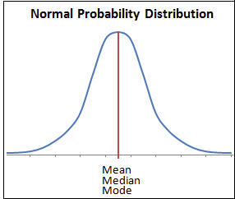
Is my data normal?
Most data follows a normal distribution
  The bulk of the data is in the middle, with a few extremes
  Intelligence, height, speed,…
  all follow a normal distribution.
    Few very tall or short people, but
    most people are of average height.
  To tell if data is normal, do a
  histogram and look at it.
  Normal distributions are bell-shaped,
  symmetrical about the mean,
  with long tails and most data in the middle.
  Calculate if the data is skewed (review an earlier topic)

Slide 4
Normal distributions
Normal distributions are continuous where any variable can have an infinite number of values
  i.e. in binomials our variable had limited possible values but normal distributions allow unlimited decimal points or fractions. 0.1, 0.001, 0.00000001, …
  If you have unlimited values, the probability of a distribution taking an exact number is zero. 1/infinity = 0
For this reason, problems in normal distributions ask for a probability between a range of values (between, more-than, or less-than questions)

Slide 5

How to calculate
We do not use a formula to calculate normal distribution probabilities, instead we use a table
  http://www.growingknowing.com/GKStatsBookNormalTable2.html
  We use one standardized table for all normal distributions.
  We standardize by creating a z score that measures the number of standard deviations above or below the mean for a value X.
μ is the mean.
σ is standard deviation.
x is the value from which you determine probability.

Slide 6
z scores to the right or above the mean are positive
z scores to the left or below the mean are negative
All probabilities are positive between 0.0 to 1.0
Probabilities above the mean total .5 and below the mean total .5
.5
.5
-z
+z

Slide 7
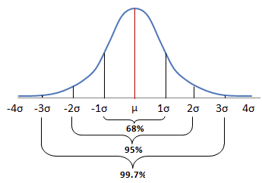
The distribution is symmetrical about the mean
  1 standard deviation above the mean is a probability of 34%
  1 standard deviation below the mean is also 34%
Knowing that the same distance above or below the mean has the same probability allows us to use half the table to measure any probability.
  If you want –z or +z, we look up only +z because the same distance gives the same probability for +z or -z

Slide 8
Three patterns of problems
Less than : lookup z table probability
More than: 1 - probability from z table lookup
Between : larger probability – smaller probability

Slide 9
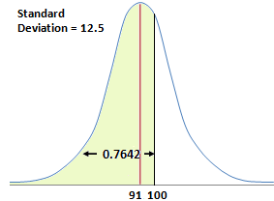
Less-than pattern, positive z score.
What is the probability of less than 100 if the mean = 91 and standard deviation = 12.5?
z₁ = (x – mean) / S.D. = (100– 91) / 12.5 = +0.72
In table, lookup z = + .72, probability = 0.7642

Slide 10
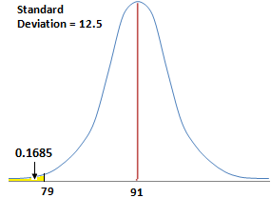
Less-than pattern, negative z score.
What is the probability of less than 79 if the mean = 91 and standard deviation = 12.5?
z₁ = (x – mean) / S.D. = (79– 91) / 12.5 = -0.96
In table, lookup z = - .96, probability = 0.1685

Slide 11
More-than pattern.
What is the probability of more than 63 if mean = 67 and standard deviation = 7.5?
z₁ = (x – mean) / S.D. = (63– 67) / 7.5 = -0.5333
In table, lookup z = - .53, probability = 0.2981
Table shows less-than so for more-than use the complement. 1 – probability of less-than
Probability more than 63: 1 - .2981 = 0.7019

Slide 12
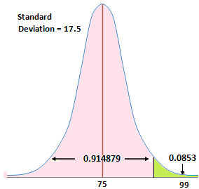
More-than pattern, positive z score.
What is the probability of more than 99 if mean = 75 and standard deviation = 17.5
z₁ = (x – mean) / S.D. = (99– 75) / 17.5 = +1.37
In table, lookup z = 1 .37, probability = 0.9147
Use complement. = 1 - 0.9147
Probability more than 99: 1 - .9147 = 0.0853

Slide 13
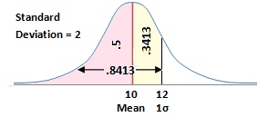
Normal distribution problems
Between Mean and positive z
Mean = 10, S.D. (standard deviation) = 2
What is the probability data would fall between 10 and 12?
z₁ = (x – mean) / S.D.
= (12 – 10) / 2 = 1
z₂ = (10 – 10 / 2 = 0
Lookup Table
  Probability for z of 1 = 0.8413
  Probability for z of 0 = 0.5000
Answer : 0.8413 - .5 = .3413
Answer 34% probability data would fall between 10 and 12

Slide 14
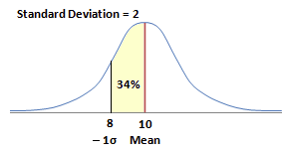
Between Mean and negative z
Mean = 10, S.D. (standard deviation) = 2
What is the probability data would fall between 10 and 8?
z₁ = (x – mean) / S.D.
= (10 – 10) / 2 = 0
z₂ = (8 – 10) / 2 = -1
  Probability Z of -1 = 0.1587
  Probability Z of 0 = 0.500
Answer : 0.5 – 0.1587 = .3413
34% probability data would fall between 8 and 10
  Probability data falls 1 S.D. below mean is 34%
  Probability data falls 1 S.D. above mean is 34%
  S0 68% of data is within 1 SD of the Mean. Empirical rule!

Slide 15
Between 2 values of X, both positive z scores
  Mean = 9, Standard deviation or S.D. = 3
What is the probability data would fall between 12 and 15?
z₁ = (x – mean) / S.D. = (15 – 9) / 3 = +2
z₂ = (x – mean) / S.D. = (12 – 9) / 3 = +1
Probability lookup z₁ = .9772
Probability lookup z₂ = .8413
Probability between 15 and 12 = .9772 - .8412
= 0.1359

Slide 16
Between 2 values of X, both with negative z scores.
What is the probability data would fall between 6 and 8, mean is 11 and standard deviation is 2?
z₁ = (x – mean) / S.D. = (8 – 11) / 2 = -1.5
z₂ = (x – mean) / S.D. = (6 – 11 / 2 = -2.5
Lookup z₁ = .0668
Lookup z₂ = .0062
Probability between 8 and 6 = .0668 - .0062
= 0.0606

Slide 17
Between 2 values of X, with different signs for z scores.
What is probability data would fall between 5 and 11, if the mean = 9 and standard deviation = 2.5?
z₁ = (x – mean) / S.D. = (11– 9) / 2.5 = +0.8
z₂ = (x – mean) / S.D. = (5– 9) / 2.5 = -1.6
Probability lookup z₁ = .7881
Probability lookup z₂ = .0548
Probability between 11 and 5 = .7881 - .0548
= 0.7333

Slide 18
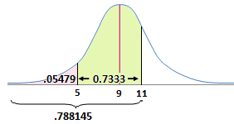
Between 2 values of X, with different signs for z scores
What is the probability data would fall between 5 and 11, if the mean = 9 and standard deviation = 2.5?

Slide 19
Go to website and do normal distribution problems

Slide 20
Z to probability
Sometimes the question gives you the z value and asks for the probability.
We proceed as before but skip the step of calculating z.
For manual users, these questions are easier than first finding z then finding the probability.

Slide 21
What is the probability for the area between z= -2.80 and z= -0.19?
Table lookup, z=-2.8, probability = .0026
Table lookup, z=-0.19, probability = .4247
Probability is .4247 - .0026 = .4221

Slide 22
What is the probability for area less than z= -0.94?
Table lookup, z= -.94, probability = .1736
What is probability for area more than z = -.98 ?
Table lookup, z=-.98, probability = .1635
More than so 1 - .1635 = .8365

Slide 23
Go to website and do z to probability problems

Slide 24
Probability to Z
We learned to calculate
  Data (mean, S.D., X) → Z → probability
  Z → probability
We can also go backwards
  probability → Z → Data (i.e. X)
This is a crucial item as probability to z is used in many other formulas such as confidence testing, hypothesis testing, and sample size.

Slide 25
Formula
If z = (x – mean) / standard deviation, we can use algebra to show
x = z(standard deviation) + mean

Slide 26
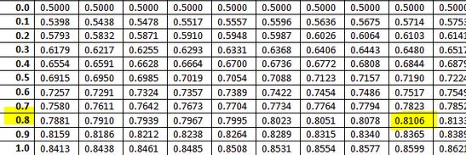
What is the z score if you have a probability of less than 81%, mean = 71, standard deviation = 26.98?
  Probability = .81, read backwards to z,
  Find closest probability is .8106 with z value = +0.88

Slide 27
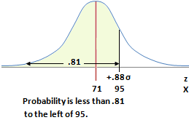
What is X if the probability is less than 81%, mean = 71, standard deviation = 26.98?
We know from last problem z = +0.88
Formula: x = z(S.D.) + mean
X = .88(26.98) + 71 = 94.74

Slide 28
You get a job offer if you can score in the top 20% of this statistics class. What grade would you need if the mean = 53, standard deviation is 14?
Top 20% says cut-off is the less-than 80%
Probability = .8, closest is 0.7995 for z =0.84
Calculate x = z(Std deviation) + mean
= .84(14) + 53 = 64.76
A grade of 65% or higher is the top 20% of the class.

Slide 29
Go to website, do probability to z questions

