Slide 1
Normal distribution
GrowingKnowing.com © 2020

Slide 2
Normal distributions
Wake-up!
  Normal distribution calculations are used constantly in the rest of the course, you must conquer this topic
  Normal distributions are common
  There are methods to use normal distributions even if you data does not follow a normal distribution

Slide 3
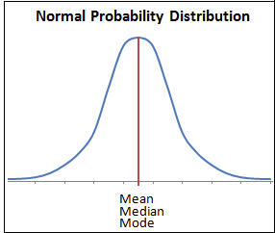
Is my data normal?
Most data follows a normal distribution
  The bulk of the data is in the middle, with a few extremes
  Intelligence, height, speed,…
  all follow a normal distribution.
    Few very tall or short people, but
    most people are of average height.
  To tell if data is normal, do a
  histogram and look at it.
  Normal distributions are bell-shaped,
  symmetrical about the mean,
  with long tails and most data in the middle.
  Calculate if the data is skewed (review an earlier topic)

Slide 4
Normal distributions
Normal distributions are continuous where any variable can have an infinite number of values
  i.e. in binomials our variable had limited possible values but normal distributions allow unlimited decimal points or fractions. 0.1, 0.001, 0.00000001, …
  If you have unlimited values, the probability of a distribution taking an exact number is zero. 1/infinity = 0
For this reason, problems in normal distributions ask for a probability between a range of values (between, more-than, or less-than questions)

Slide 5

How to calculate
We do not use a formula to calculate normal distribution probabilities, instead we use a table
  http://www.growingknowing.com/GKStatsBookNormalTable1.html
Every normal distribution may be different, but we can use one table for all these distributions by standardizing them.
  We standardize by creating a z score that measures the number of standard deviations above or below the mean for a value X.
μ is the mean.
σ is standard deviation.
x is the value from which you determine probability.

Slide 6
z scores to the right or above the mean are positive
z scores to the left or below the mean are negative
All probabilities are positive between 0.0 to 1.0
Probabilities above the mean total .5 and below the mean total .5
.5
.5
-z
+z

Slide 7
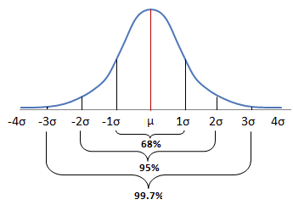
The distribution is symmetrical about the mean
  1 standard deviation above the mean is a probability of 34%
  1 standard deviation below the mean is also 34%
Knowing that the same distance above or below the mean has the same probability allows us to use half the table to measure any probability.
  If you want –z or +z, we look up only +z because the same distance gives the same probability for +z or -z

Slide 8
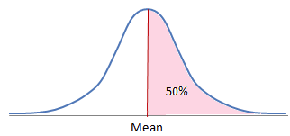
Half the probabilities are below the mean
Knowing each half of the distribution is .5 probability is useful.
The table only gives us a probability between the mean and a +z score, but for any other type of problem we add or subtract .5 to obtain the probability we need as the following examples will demonstrate.

Slide 9
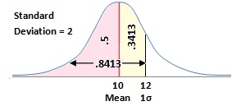
Normal distribution problems
Between Mean and positive z
Mean = 10, S.D. (standard deviation) = 2
What is the probability data would fall between 10 and 12?
Use =norm.dist(x ,mean, S.D. ,1)
=norm.dist(12,10,2,1)-norm.dist(10,10,2,1)
= .8413 - .5 = .3413 = 34%

Slide 10
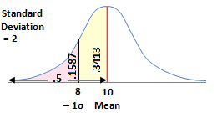
Between Mean and negative z
Mean = 10, S.D. (standard deviation) = 2
What is the probability data would fall between 10 and 8?
=norm.dist(10,10,2,1)-norm.dist(8,10,2,1)
= .5 - .1587 = .3413
Answer 34%

Slide 11
Between 2 values of X
  Mean = 9, Standard deviation or S.D. = 3
What is the probability data would fall between 12 and 15?
=norm.dist(15,9,3,1)-norm.dist(12,9,3,1) = 0.1359

Slide 12
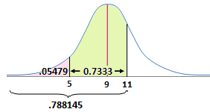
Between 2 values of X
What is probability data would fall between 5 and 11, if the mean = 9 and standard deviation = 2.5?
=norm.dist(11,9,2.5,1)-norm.dist(5,9,2.5,1)
= .788145 - .054799
= 0.7333

Slide 13
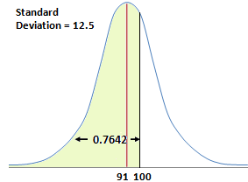
Less-than pattern
What is the probability of less than 100 if the mean = 91 and standard deviation = 12.5?
=norm.dist(100,91,12.5,1)
= 0.7642

Slide 14
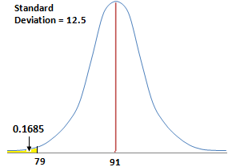
Less-than pattern
What is the probability of less than 79 if the mean = 91 and standard deviation = 12.5?
=norm.dist(79,91,12.5,1)
= 0.1685

Slide 15
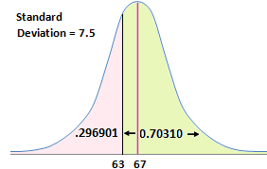
More-than pattern
What is the probability of more than 63 if mean = 67 and standard deviation = 7.5?
=1-norm.dist(63,67,7.5,1)
=1 - .296901
= 0.70310
= 70%

Slide 16
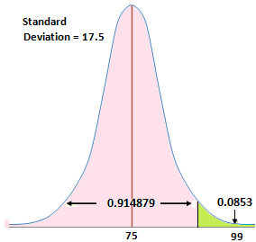
More-than pattern
What is the probability of more than 99 if mean = 75 and standard deviation = 17.5
=1-norm.dist(99,75,17.5,1)
= 1 - .914879
= 0.0853

Slide 17
Summary so far
Less than: plug values into function
More than: = 1 – function
Between: =function – function
Use =norm.dist(x,mean,std deviation, 1) for the function if it is a normal distribution problem.

Slide 18
Go to website and do normal distribution problems

Slide 19
Z to probability
Sometimes the question gives you the z value, and asks for the probability.
For Excel users, this means you use =norm.S.dist(z) instead of =norm.dist for the function.
The only difference is the S in the middle of norm.S.dist
You will know if you are using the wrong function, because
  =norm.S.dist only asks for the z value
  =norm.dist asks for x, mean, std deviation, and cumulative
Pay attention to the use of negatives
  Subtracting using a negative sign =norm.s.dist – norm.s.dist
  Negative z value. =norm.S.dist(-z,1)

Slide 20
What is the probability for the area between z= -2.80 and z= -0.19?
-norm.S.dist(z,1)
  We always add the ‘,1’ after the z value
=norm.S.dist(-.19,1) – norm.S.dist(-2.8,1)
= .422
Don’t forget the negative sign for z if z is negative
Notice negative z sign in the brackets versus negative sign for subtraction between the functions
Notice the larger negative value has a smaller absolute number

Slide 21
What is the probability for area less than z= -0.94?
=norm.s.dist(-0.94,1)
= .174
What is probability for area more than z = -.98 ?
=1-norm.s.dist(-.98,1)
= .8365

Slide 22
Go to website and do z to probability problems

Slide 23
Probability to Z
We learned to calculate
  Data (mean, S.D., X) → =norm.dist → probability
  Z → =norm.S.dist→ probability
We can also go backwards
  probability → =norm.s.inv → Z
  Probability → =norm.inv → X
This is a crucial item as probability to z is used in many other formulas such as confidence testing, hypothesis testing, and sample size.

Slide 24
Formula
If z = (x – mean) / standard deviation, we can use algebra to show
x = z(standard deviation) + mean

Slide 25
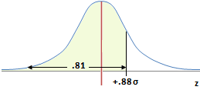
What is a z score for a probability of less than 81%, mean = 71, standard deviation = 26.98?
  =norm.s.inv(probability)
  =norm.s.inv(.81)
  = +0.88
We will do many more of this type of question in later chapters of the course.

Slide 26
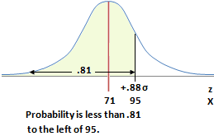
What is X if the probability is less than 81%, mean = 71, standard deviation = 26.98?
=norm.inv(probability, mean, std deviation)
=norm.inv(.81,71,26.98)
= 94.74
= 95
Use NORM.S.INV for probability to Z value
Use NORM.INV for probability to X value

Slide 27
You get a job offer if you can score in the top 20% of our statistics class. What grade would you need if mean = 53, standard deviation is 14?
=norm.inv(.8,53,14)
= 64.78
Answer: You need 65 or higher to be in the top 20% of the class.
Notice the value of X dividing the top 20% of the class from the bottom 80% is exactly the same whether you count from 0% up to 80%, or count down from 100% to 80%.
Excel is better counting from 0 up, so we use 80%.
Whether the question asks for more than 80% or less than 80%, the value of X at that dividing point is the same so X, unlike probability, does not require the =1 – function method.

Slide 28
Go to website, do probability to z questions

