Slide 1
Hypothesis Part 2
Manual
GrowingKnowing.com © 2011

Slide 2
Small Samples
If your sample size is below 30, this is a small sample so use the t table, not z.
Decision rule changes to t table
Test statistic uses the same formula
  (sample mean – population mean) / std deviation
    but the result is t instead z
The other methods are the same as large samples.
Examples will show what has changed, and reinforce what has not changed.

Slide 3
Sample Size | Do you know the value for σ? | Use
≥ 30 | No | z
≥ 30 | Yes | z
< 30 | Yes | z
< 30 | No | t
Use t if the sample size is under 30
And you do not know the population standard deviation.

Slide 4
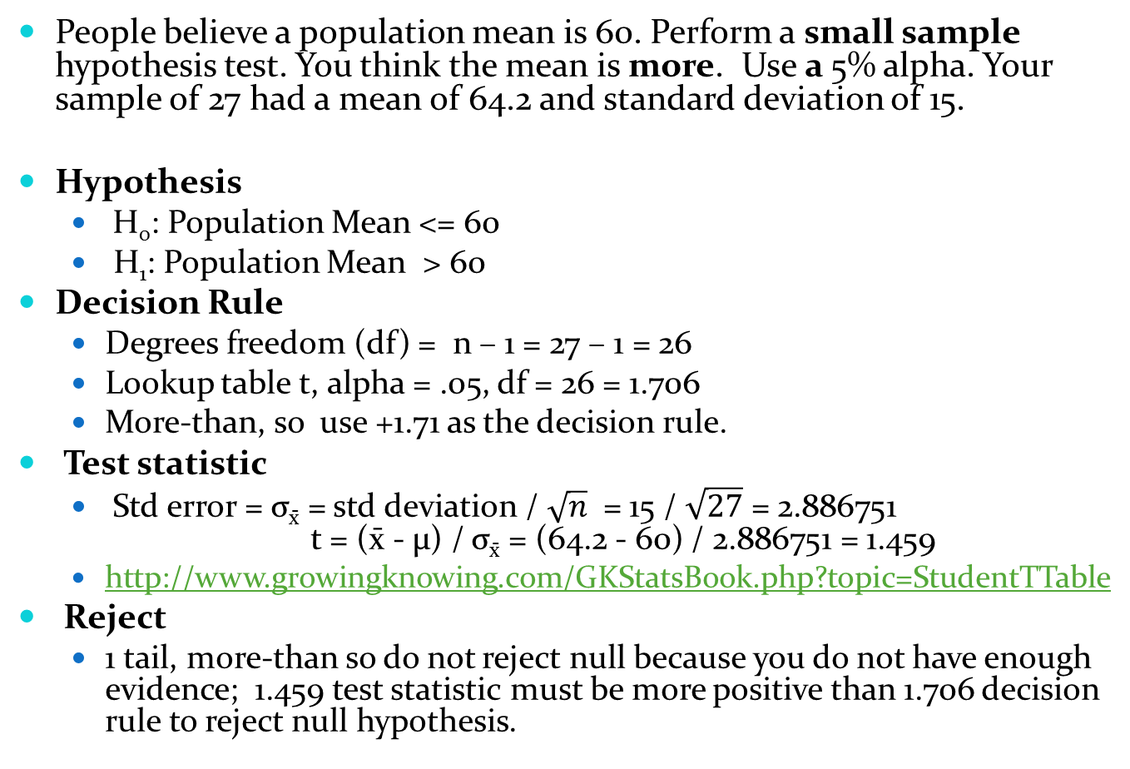
People believe a population mean is 60. Perform a small sample hypothesis test. You think the mean is more. Use a 5% alpha. Your sample of 27 had a mean of 64.2 and standard deviation of 15.
Hypothesis
  H₀: Population Mean <= 60
  H₁: Population Mean > 60
Decision Rule
  Degrees freedom (df) = n – 1 = 27 – 1 = 26
  Lookup table t, alpha = .05, df = 26 = 1.706
  More-than, so use +1.71 as the decision rule.
Test statistic
  Std error = σ_{x̄} = std deviation / $\sqrt{n}$ = 15 / $\sqrt{27}$ = 2.886751
  t = (x̄ - μ) / σ_{x̄} = (64.2 - 60) / 2.886751 = 1.459
  http://www.growingknowing.com/GKStatsBook.php?topic=StudentTTable
Reject
  1 tail, more-than so do not reject null because you do not have enough evidence; 1.459 test statistic must be more positive than 1.706 decision rule to reject null hypothesis.

Slide 5
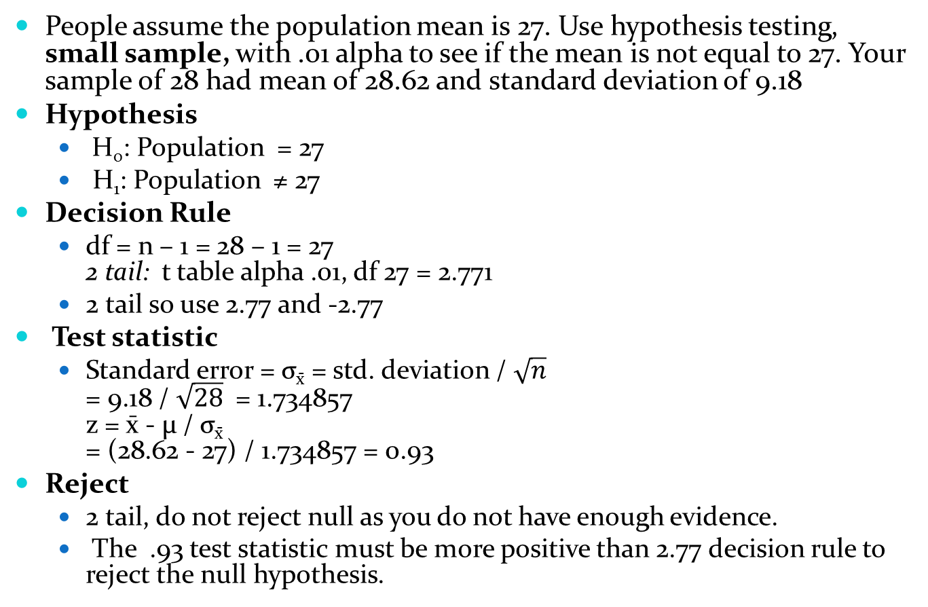
People assume the population mean is 27. Use hypothesis testing, small sample, with .01 alpha to see if the mean is not equal to 27. Your sample of 28 had mean of 28.62 and standard deviation of 9.18
Hypothesis
  H₀: Population = 27
  H₁: Population ≠ 27
Decision Rule
  df = n – 1 = 28 – 1 = 27
  2 tail: t table alpha .01, df 27 = 2.771
  2 tail so use 2.77 and -2.77
Test statistic
  Standard error = σ_{x̄} = std. deviation / $\sqrt{n}$
  = 9.18 / $\sqrt{28}$ = 1.734857
  z = x̄ - μ / σ_{x̄}
  = (28.62 - 27) / 1.734857 = 0.93
Reject
  2 tail, do not reject null as you do not have enough evidence.
  The .93 test statistic must be more positive than 2.77 decision rule to reject the null hypothesis.

Slide 6
Hypothesis P-values
Another method of hypothesis testing is p-values which looks at the probability of a value falling into the rejection region
The decision rule is easier, you use the alpha value directly and do not calculate a z score.
The test statistic for manual users converts the z value to a probability so requires an extra step.
  For a 2 tail test, use p-value multiplied by 2 to compare with alpha
The larger the p-value, the stronger your evidence for the null hypothesis.
If your p-value is smaller than alpha, you reject the null hypothesis.

Slide 7
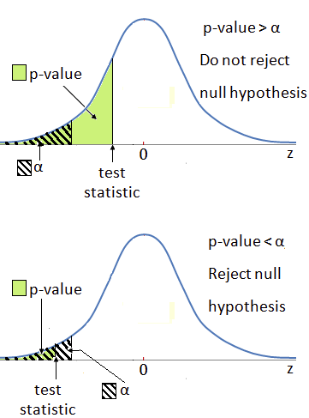

Slide 8
P-value evidence
P-values can be used as a guideline for the strength of your evidence for rejecting the null hypothesis
P-value | Evidence
Larger than .10 | No evidence
More .05, equal or less than .1 | Weak evidence
More .01 , equal or less than .05 | Strong evidence
Less than or equal .01 | Overwhelming evidence

Slide 9
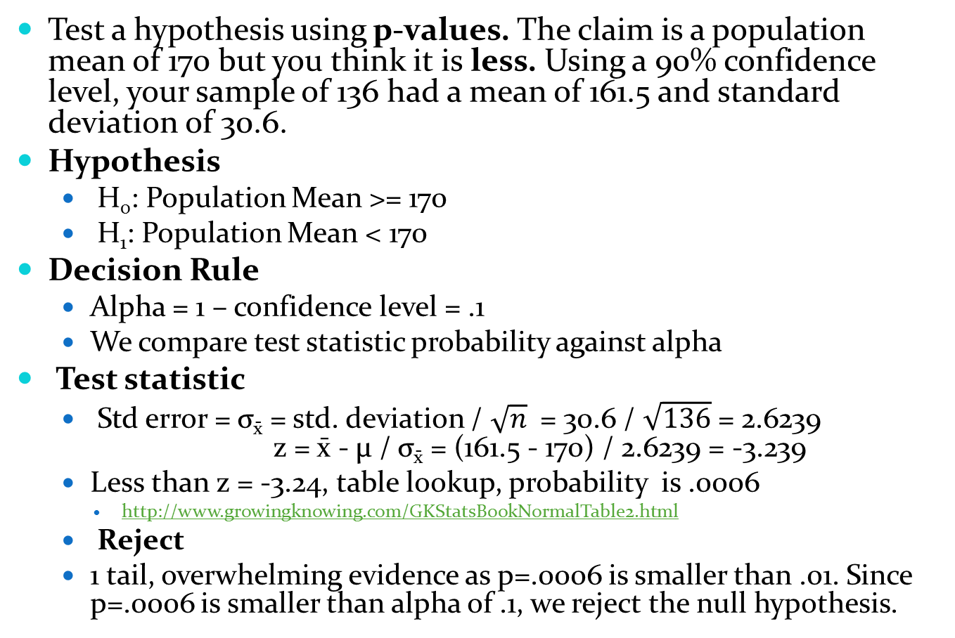
Test a hypothesis using p-values. The claim is a population mean of 170 but you think it is less. Using a 90% confidence level, your sample of 136 had a mean of 161.5 and standard deviation of 30.6.
Hypothesis
  H₀: Population Mean >= 170
  H₁: Population Mean < 170
Decision Rule
  Alpha = 1 – confidence level = .1
  We compare test statistic probability against alpha
Test statistic
  Std error = σ_{x̄} = std. deviation / $\sqrt{n}$ = 30.6 / $\sqrt{136}$ = 2.6239
  z = x̄ - μ / σ_{x̄} = (161.5 - 170) / 2.6239 = -3.239
  Less than z = -3.24, table lookup, probability is .0006
    http://www.growingknowing.com/GKStatsBookNormalTable2.html
  Reject
  1 tail, overwhelming evidence as p=.0006 is smaller than .01. Since p=.0006 is smaller than alpha of .1, we reject the null hypothesis.

Slide 10
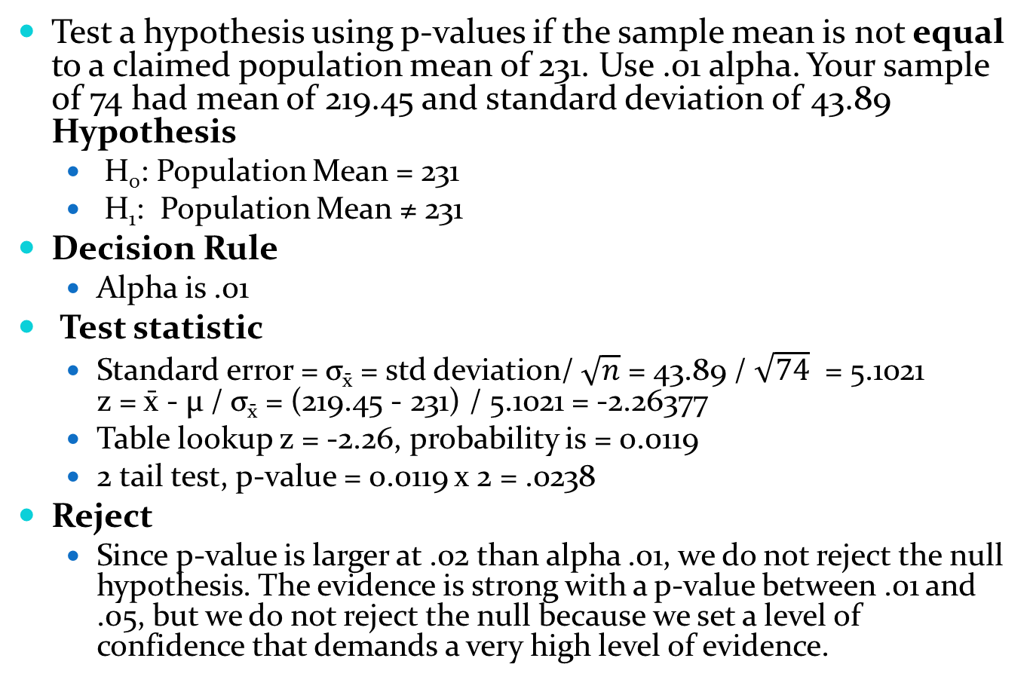
Test a hypothesis using p-values if the sample mean is not equal to a claimed population mean of 231. Use .01 alpha. Your sample of 74 had mean of 219.45 and standard deviation of 43.89 Hypothesis
  H₀: Population Mean = 231
  H₁: Population Mean ≠ 231
Decision Rule
  Alpha is .01
Test statistic
  Standard error = σ_{x̄} = std deviation/ $\sqrt{n}$ = 43.89 / $\sqrt{74}$ = 5.1021
  z = x̄ - μ / σ_{x̄} = (219.45 - 231) / 5.1021 = -2.26377
  Table lookup z = -2.26, probability is = 0.0119
  2 tail test, p-value = 0.0119 x 2 = .0238
Reject
  Since p-value is larger at .02 than alpha .01, we do not reject the null hypothesis. The evidence is strong with a p-value between .01 and .05, but we do not reject the null because we set a level of confidence that demands a very high level of evidence.

Slide 11
Go to website, do Hypothesis Small Sample

