Slide 1
Hypothesis Test II the sequel
GrowingKnowing.com © 2020

Slide 2
Small Samples
If your sample size is below 30, this is a small sample so use the t table, not z.
Decision rule uses =t.inv instead of =normsinv
  Excel: 2-tail: t =t.inv.2t(alpha, degrees of freedom)
  Excel: 1-tail: t =t.inv(alpha, degrees of freedom)
Test statistic uses the same formula
  (sample mean – population mean) / std error
    but the result is t instead z
The other methods are the same as large samples.
Examples will show what has changed, and reinforce what has not changed.

Slide 3
Sample Size | Do you know the value for σ? | Use
≥ 30 | No | z
≥ 30 | Yes | z
< 30 | Yes | z
< 30 | No | t
Use t if the sample size is under 30
And you do not know the population standard deviation.

Slide 4
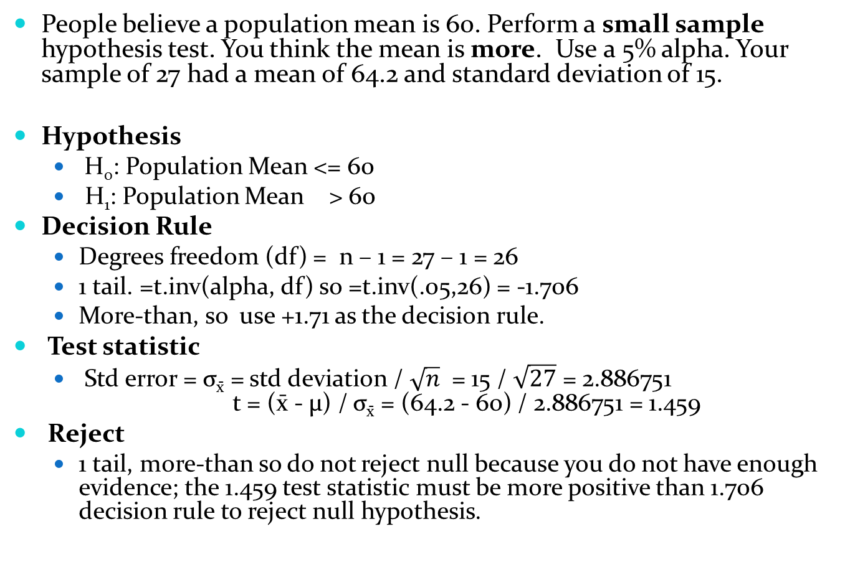
People believe a population mean is 60. Perform a small sample hypothesis test. You think the mean is more. Use a 5% alpha. Your sample of 27 had a mean of 64.2 and standard deviation of 15.
Hypothesis
  H₀: Population Mean <= 60
  H₁: Population Mean > 60
Decision Rule
  Degrees freedom (df) = n – 1 = 27 – 1 = 26
  1 tail. =t.inv(alpha, df) so =t.inv(.05,26) = -1.706
  More-than, so use +1.71 as the decision rule.
Test statistic
  Std error = σ_{x̄} = std deviation / $\sqrt{n}$ = 15 / $\sqrt{27}$ = 2.886751
  t = (x̄ - μ) / σ_{x̄} = (64.2 - 60) / 2.886751 = 1.459
Reject
  1 tail, more-than so do not reject null because you do not have enough evidence; the 1.459 test statistic must be more positive than 1.706 decision rule to reject null hypothesis.

Slide 5
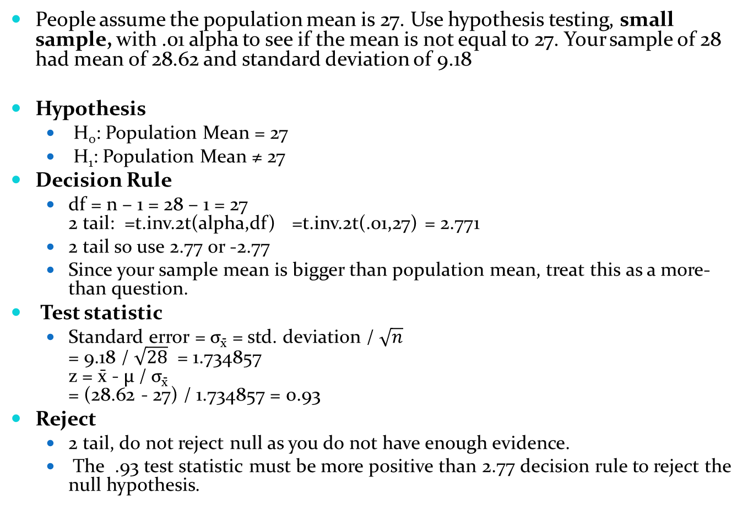
People assume the population mean is 27. Use hypothesis testing, small sample, with .01 alpha to see if the mean is not equal to 27. Your sample of 28 had mean of 28.62 and standard deviation of 9.18
Hypothesis
  H₀: Population Mean = 27
  H₁: Population Mean ≠ 27
Decision Rule
  df = n – 1 = 28 – 1 = 27
  2 tail: =t.inv.2t(alpha,df) =t.inv.2t(.01,27) = 2.771
  2 tail so use 2.77 or -2.77
  Since your sample mean is bigger than population mean, treat this as a more-than question.
Test statistic
  Standard error = σ_{x̄} = std. deviation / $\sqrt{n}$
  = 9.18 / $\sqrt{28}$ = 1.734857
  z = x̄ - μ / σ_{x̄}
  = (28.62 - 27) / 1.734857 = 0.93
Reject
  2 tail, do not reject null as you do not have enough evidence.
  The .93 test statistic must be more positive than 2.77 decision rule to reject the null hypothesis.

Slide 6
Hypothesis P-values
Another method of hypothesis testing is p-values which looks at the probability of a value falling into the rejection region
The decision rule is easier, you use the alpha value directly so do not have to find the decision rule z score.
The test statistic for Excel users is easier use =norm.dist(x,mean,std deviation,1) for 1 tail less-than
=1-norm.dist(x,mean,std deviation,1) for 1 tail more-than
  where x is the sample mean, mean is population mean, std deviation is divided by sqrt(n) as shown in central limit theory.
  For 2 tail test, use less-than formula if sample mean is smaller than population mean, and use more-than formula is sample mean is larger than population mean. Once you have the p-value, multiply by 2 for 2 tail tests.
If your p-value is smaller than alpha, you reject the null hypothesis.

Slide 7
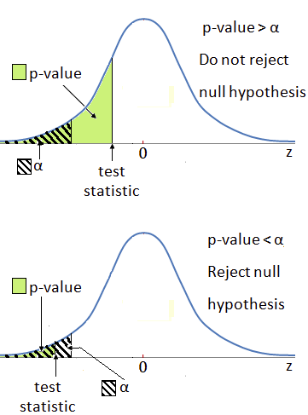

Slide 8
P-value evidence
P-values can be used as a guideline for the strength of your evidence for rejecting the null hypothesis
P-value | Evidence
Larger than .10 | No evidence
More .05, equal or less than .1 | Weak evidence
More .01 , equal or less than .05 | Strong evidence
Less than or equal .01 | Overwhelming evidence

Slide 9
Test a hypothesis using p-values. The claim is a population mean of 170 but you think it is less. Using a 90% confidence level, your sample of 136 had a mean of 161.5 and standard deviation of 30.6.
Hypothesis
  H₀: Population >= 170
  H₁: Population < 170
Decision Rule
  Alpha = 1 – confidence level = .1
  We compare test statistic probability against alpha
Test statistic
  =norm.dist(sample mean, population mean, std deviation/sqrt(n), 1)
  =norm.dist(161.5,170,30.6/SQRT(136),1) = 0.0006
Reject
  1 tail, overwhelming evidence as p=.0006 is smaller than .01. Since p=.0006 is smaller than alpha of .1, we reject the null hypothesis.

Slide 10
Test a hypothesis using p-values if the sample mean is not equal to a claimed population mean of 231. Use .01 alpha. Your sample of 74 had mean of 219.45 and standard deviation of 43.89
Hypothesis
  H₀: Population Mean = 231
  H₁: Population Mean ≠ 231
Decision Rule
  Alpha is .01
Test statistic
  Sample mean is less than population mean so treat as a 1 tail less-than test
  =norm.dist(219.45,231,43.89/SQRT(74),1) = 0.0118
  2 tail test, p-value = 0.0118 x 2 = .0236
Reject
  Since p-value is larger at .02 than alpha .01, we do not reject the null hypothesis. The evidence is strong with a p-value between .01 and .05, but we do not reject the null because we set a level of confidence that demands a very high level of evidence.

Slide 11
Go to website, do Hypothesis Small Sample and Hypothesis P-value questions

