Slide 1
Hypothesis Tests
Excel
GrowingKnowing.com © 2020

Slide 2
There are 5 steps
Step 1: State the null and alternative hypothesis
Step 2: Select a confidence level
Step 3: Determine the decision rule
Step 4: Calculate the test statistic
Step 5: Reject or don’t reject the null hypothesis

Slide 3
Hypothesis Tests
Hypothesis Testing is a way to test claims and beliefs about population parameters using sample data.
Hypothesis testing is one of the reasons why scientific methods are so successful.
This is a powerful method to advance knowledge,
  our quest for advances in chemistry, biology, physics, marketing, …
Hypothesis testing works with a pair of hypotheses (Ho and H1)
  Null hypothesis is H0
  Alternative hypothesis is H1
The Alternative hypothesis is the idea you want to prove
  Null hypothesis is everything else, the opposite of the alternative .
Example
  Ho Politicians are morons
  H1 Politicians are not morons

Slide 4
The rules for stating the hypothesis
Your hypothesis must be exhaustive, mutually exclusive, and you must be able to test the idea.
  Exhaustive – this means the result always falls into H0 or H1 but never outside of both or between both.
  Mutually exclusive – the result falls into H0 or H1 but never both at the same time.
  Testable – do not state a hypothesis you cannot test.
    H1: Nothing cures cancer.
      you cannot test everything in a lifetime, so this statement is not testable.

Slide 5
Stating the hypothesis
Begin with your alternative hypothesis, the idea you want to prove
  H1: Ginger cures cancer
Now formulate the null hypothesis which is the opposite
  H0: Ginger does not cure cancer
Review against the rules
  Testable: It is easy to test, put cancer cells in dish, inject ginger, see if cancer dies.
  Exhaustive: It will work or it won’t, there is no other possible result.
  Mutually exclusive: results will be cure or don’t cure, you cannot be in both at the same time. If ginger helps but does not cure you, then you are not cured.

Slide 6
Stating the Hypothesis
The hypothesis statement is not easy.
  Expect to spend time on this step, discuss it, check with your boss, have many versions to choose from, make sure you got it right.
The hypothesis statement is a common source of error.
The main idea is H1 is what you want or are asked to test.
Example:
  The company believes they make 10 cars a day. You want to prove they do.
    H1: They make 10 cars a day
  The company believes they make 10 cars a day. You don’t believe it.
    H1: They do not make 10 cars a day
Notice in the example, the claim is the same, you need to read carefully to see what you are asked to test.

Slide 7
Who has two tails?
All hypothesis tests are 1-tail or 2-tail.
In a 1 tail test, you want to test whether a condition is too small or large, but you only care about one. Either less-than, or more-than, but not both.
  H1 Grades in statistics are more-than 70% (H1 Grades > 70%)
In a 2 tail test, we care about equal or not equal because any condition outside the expected value is important.
  You want to prove global warming changed hurricanes.
    H1: Number hurricanes ≠ last year’s total

Slide 8
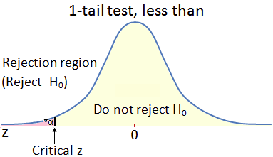
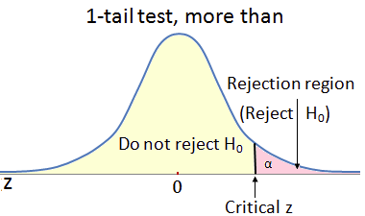
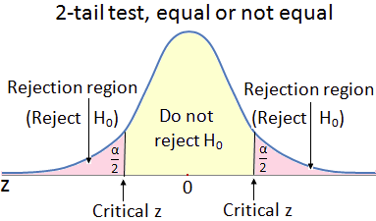

Slide 9
Set the confidence level
Pick a confidence level.
If the decision is important, you want high confidence.
  In business, the important decision usually involves lots of money.
  To invest $1 dollar, confidence can be low.
  To invest $1 million dollars, I want to be sure my investment is good so use 99% level of confidence.

Slide 10
Type I and Type II errors
Type I (alpha) is the error scientists want to avoid most so we see high confidence levels set of 90%, 95%, or 99% instead of 50% or 51%.
Type I is you reject the null hypothesis in error.
  Think of it as a false positive.
It’s embarrassing to publish H1 test results that are wrong.
Type II (beta) is you do not reject the null hypothesis in error.
  Think of it as a false negative.
You found a cure for cancer but you don’t realize it.
This is less damaging to your career but the world is denied progress.
If you reduce the chance of a Type I error, you increase your chance for a Type II error and visa-versa. The less chance of a false positive, the more chance of a false negative or visa-versa.

Slide 11
Determine the decision rule
You set confidence level, now calculate the decision rule.
  You want to be 90% confident, but what is the specific value, the critical rejection point, for 90% confidence?
We use a z score.
  1 tail test: z =norm.s.inv(confidence level)
    Less-than 1 tail: set z value as negative
    More-than 1 tail: set z value as positive
  2 tail test: z =norm.s.inv(confidence level + alpha/2)
    2 tail test, z is on both sizes, both positive and negative.

Slide 12
Decision rule examples
Confidence level is 99%.
H1: Sample mean is less than population mean of 100
  z =norm.s.inv(confidence) so =norm.s.inv(.99) = 2.33
  1 tail, less-than, set decision rule to less than -2.33.
  1 tail, more-than, set decision rule to more than +2.33
Confidence level = 90%
H1: Sample mean not equal to population mean of 100
  z =norm.s.inv(confidence level + alpha/2)
  = norm.s.inv(.9 + .1/2) = 1.64
  2 tail, our decision rule is more +1.64 or less than -1.64

Slide 13
Common decision rule z values
Confidence level | 1 tail | 2 tail
90% | 1.28 | 1.64
95% | 1.64 | 1.96
99% | 2.33 | 2.58
If you paid attention, you noticed sometimes the z score is the same as confidence levels and sometimes not. The reason is the number of tails used in hypothesis.

Slide 14
Common Confidence Levels and z Scores
Confidence Level | Alpha | Alpha/2 | One-Tail z Score | Two-Tail z Score
0.90 | 0.10 | 0.10/2 = 0.05 | =norm.s.inv(.90) = 1.28 | =norm.s.inv(.90 + .05) = 1.64
0.95 | 0.05 | 0.05/2 = 0.025 | =norm.s.inv(.95) = 1.64 | =norm.s.inv(.95 + .025) = 1.96
0.99 | 0.01 | 0.01/2 = 0.005 | =norm.s.inv(.99) = 2.33 | =norm.s.inv(.99 + .005) = 2.58

Slide 15


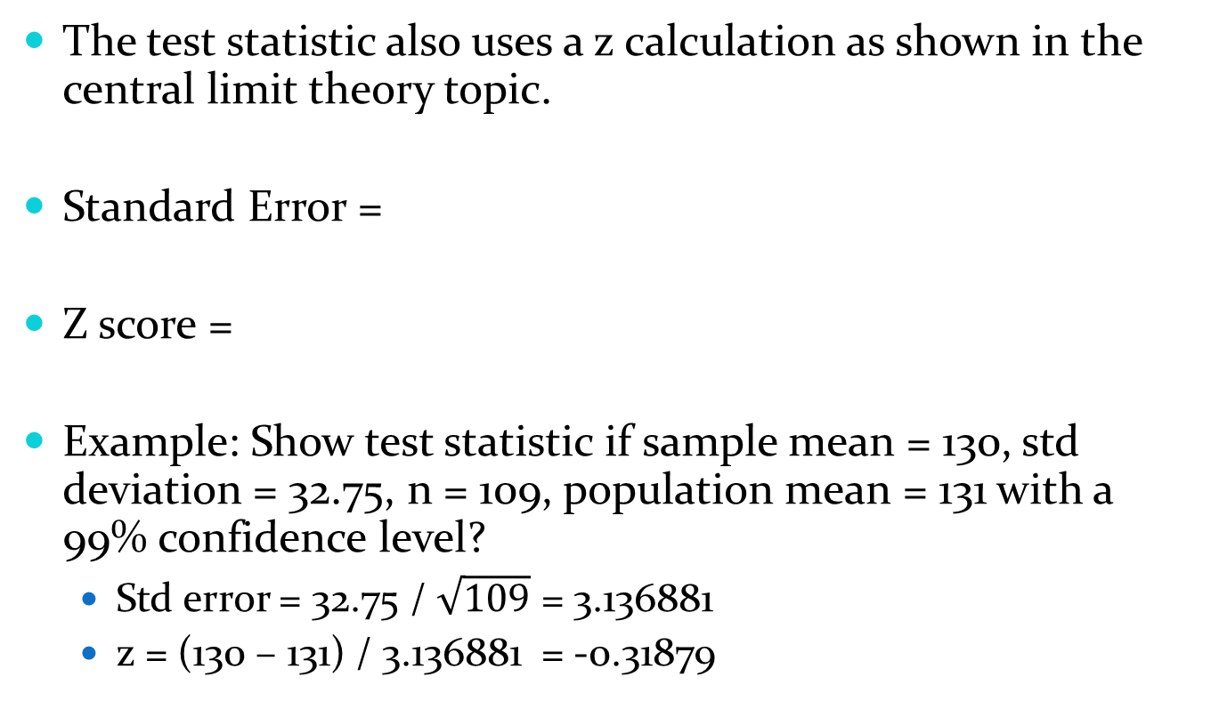
Test statistic
The test statistic also uses a z calculation as shown in the central limit theory topic.
Standard Error =
Z score =
Example: Show test statistic if sample mean = 130, std deviation = 32.75, n = 109, population mean = 131 with a 99% confidence level?
  Std error = 32.75 / $\sqrt{109}$ = 3.136881
  z = (130 – 131) / 3.136881 = -0.31879

Slide 16
Z scores.
Did the investment grow or scientific experiment prove itself with enough evidence?
  Was the growth statistically significant to reject H0?
  Could it have happened by chance?
We compare the two z values, decision rule and test statistic, and we will know if there is enough evidence.

Slide 17
Reject or don’t reject the null
2 choices:
  Reject the null hypothesis
  Do not reject the null hypothesis.
The odd language avoids saying ‘I accept my hypothesis’
  The reason is science believes any good idea can be replaced with a better idea at any time.
You never prove an idea is true
  A better idea may arrive anytime so how do you change if your old idea was proven true?
“Yippee, my horse did not lose” is a odd way of saying it won.
‘Reject the null’, or ‘Do not reject the null’ allows you to easily replace knowledge with better knowledge.

Slide 18
When H₁ test results are: | Do Say | Do NOT Say
True | "I reject the null hypothesis." | "I accept the alternative hypothesis."
 |  | "The alternative hypothesis is true"."
False | "I do not reject the null hypothesis." | "I accept the null hypothesis."
 |  | "The null hypothesis is true."

Slide 19
Reject?
2 tail, reject H0 if test statistic is more negative or more positive than the decision rule.
1 tail, reject H0 if the test statistic is more negative than decision rule for a less-than question
1 tail, reject H0 if the test statistic is more positive than decision rule for a more-than question
Example.
  Test statistic = -3.1, Decision rule = -2.33.
  Reject H0 for 1 tail less-than, or for 2 tail question.
  Do not reject for 1 tail more-than

Slide 20
Conquer your world?
You now have the skills to do a real scientific study.
Find an interesting topic and form the hypothesis
Gather data, calculate mean and standard deviation
Test hypothesis
Write up a paper
Send to newspapers and journals
Become famous, go on TV, … make money, date movie stars, buy sports cars, …

Slide 21
Examples

Slide 22
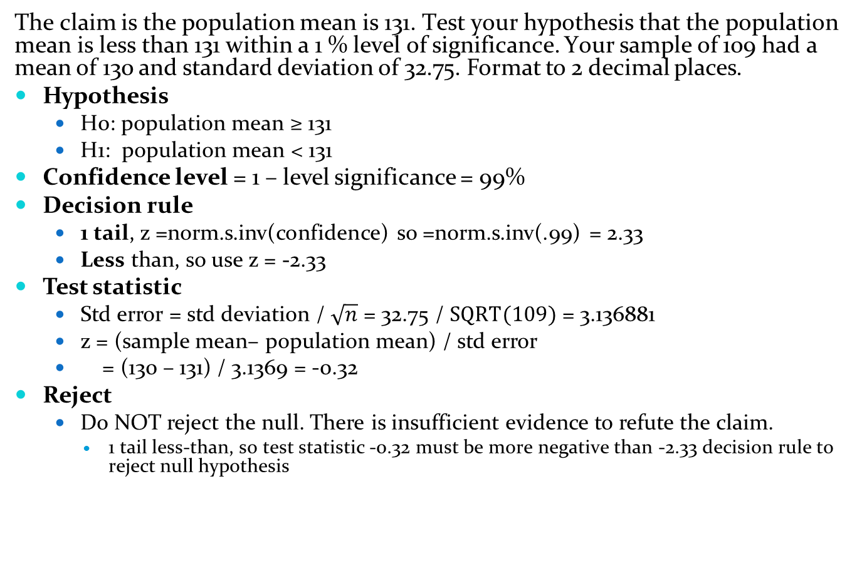
The claim is the population mean is 131. Test your hypothesis that the population mean is less than 131 within a 1 % level of significance. Your sample of 109 had a mean of 130 and standard deviation of 32.75. Format to 2 decimal places.
Hypothesis
  H0: population mean ≥ 131
  H1: population mean < 131
Confidence level = 1 – level significance = 99%
Decision rule
  1 tail, z =norm.s.inv(confidence) so =norm.s.inv(.99) = 2.33
  Less than, so use z = -2.33
Test statistic
  Std error = std deviation / $\sqrt{n}$ = 32.75 / $SQRT(109)$ = 3.136881
  z = (sample mean– population mean) / std error
  = (130 – 131) / 3.1369 = -0.32
Reject
  Do NOT reject the null. There is insufficient evidence to refute the claim.
    1 tail less-than, so test statistic -0.32 must be more negative than -2.33 decision rule to reject null hypothesis

Slide 23
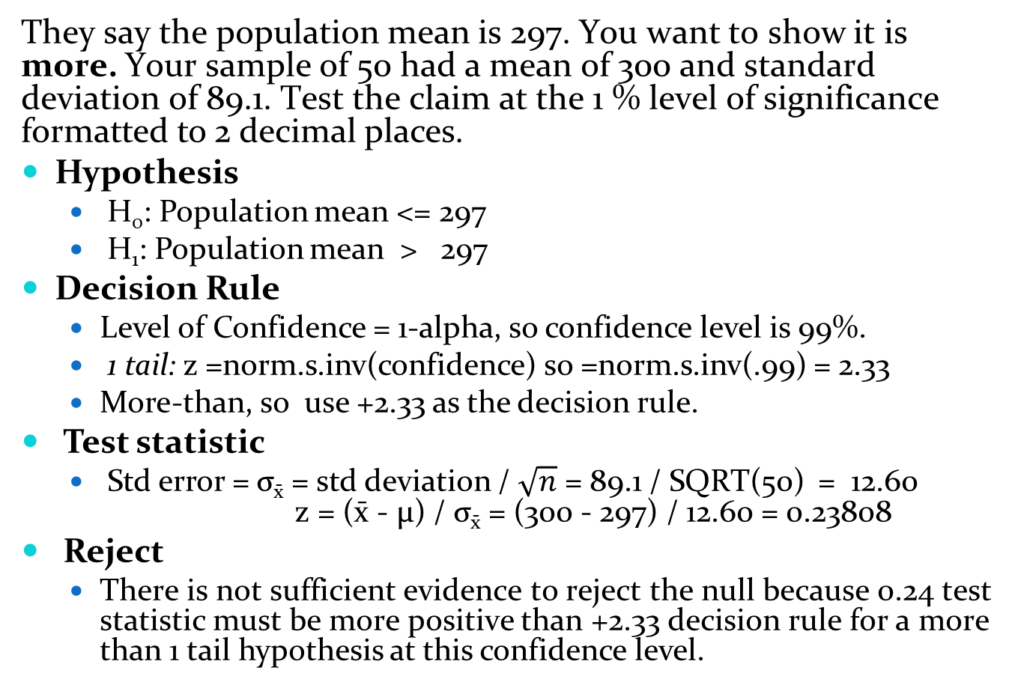
They say the population mean is 297. You want to show it is more. Your sample of 50 had a mean of 300 and standard deviation of 89.1. Test the claim at the 1 % level of significance formatted to 2 decimal places.
Hypothesis
  H₀: Population mean <= 297
  H₁: Population mean > 297
Decision Rule
  Level of Confidence = 1-alpha, so confidence level is 99%.
  1 tail: z =norm.s.inv(confidence) so =norm.s.inv(.99) = 2.33
  More-than, so use +2.33 as the decision rule.
Test statistic
  Std error = σ_{x̄} = std deviation / $\sqrt{n}$ = 89.1 / SQRT(50) = 12.60
  z = (x̄ - μ) / σ_{x̄} = (300 - 297) / 12.60 = 0.23808
Reject
  There is not sufficient evidence to reject the null because 0.24 test statistic must be more positive than +2.33 decision rule for a more than 1 tail hypothesis at this confidence level.

Slide 24
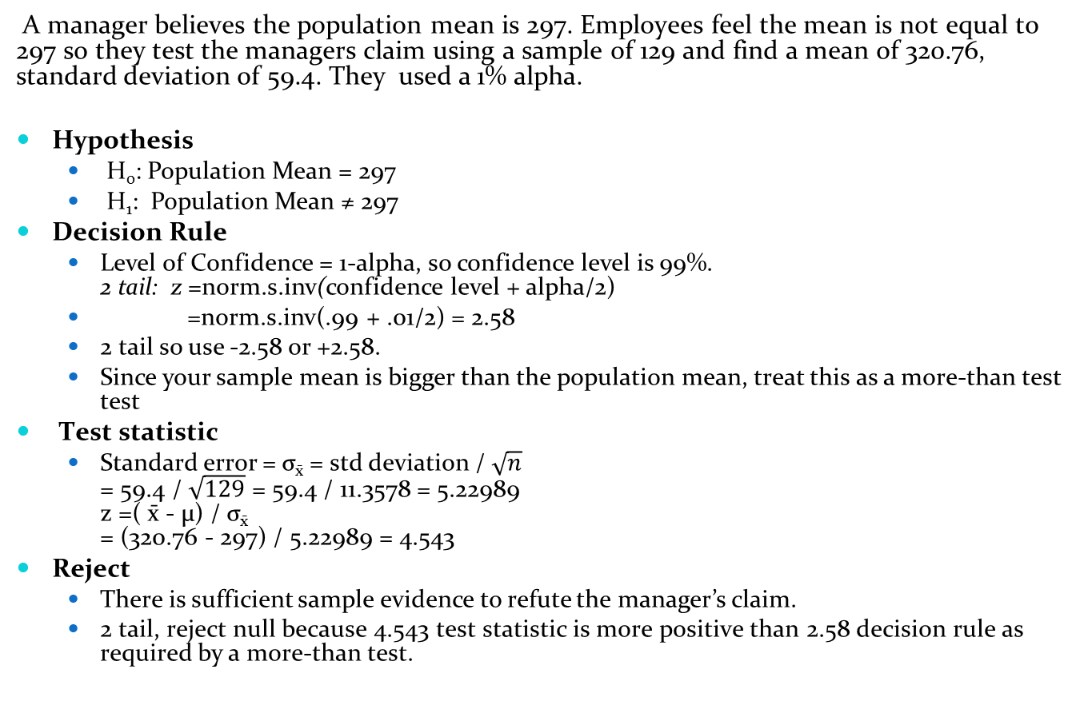
A manager believes the population mean is 297. Employees feel the mean is not equal to 297 so they test the managers claim using a sample of 129 and find a mean of 320.76, standard deviation of 59.4. They used a 1% alpha.
Hypothesis
  H₀: Population Mean = 297
  H₁: Population Mean ≠ 297
Decision Rule
  Level of Confidence = 1-alpha, so confidence level is 99%.
  2 tail: z =norm.s.inv(confidence level + alpha/2)
  =norm.s.inv(.99 + .01/2) = 2.58
  2 tail so use -2.58 or +2.58.
  Since your sample mean is bigger than the population mean, treat this as a more-than test
Test statistic
  Standard error = σ_{x̄} = std deviation / $\sqrt{n}$
  = 59.4 / $\sqrt{129}$ = 59.4 / 11.3578 = 5.22989
  z =( x̄ - μ) / σ_{x̄}
  = (320.76 - 297) / 5.22989 = 4.543
Reject
  There is sufficient sample evidence to refute the manager’s claim.
  2 tail, reject null because 4.543 test statistic is more positive than 2.58 decision rule as required by a more-than test.

Slide 25
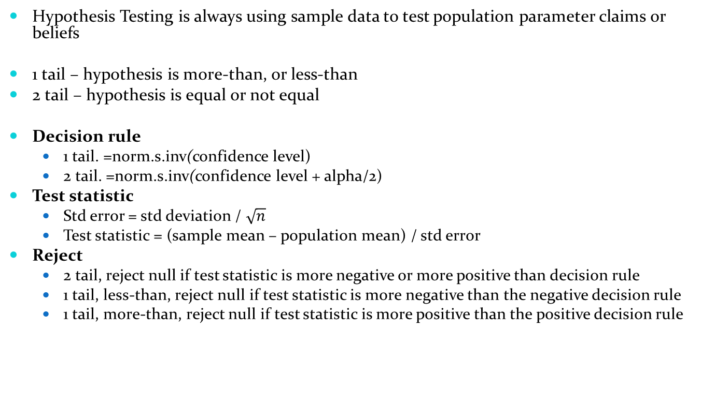
Summary
Hypothesis Testing is always using sample data to test population parameter claims or beliefs
1 tail – hypothesis is more-than, or less-than
2 tail – hypothesis is equal or not equal
Decision rule
  1 tail. =norm.s.inv(confidence level)
  2 tail. =norm.s.inv(confidence level + alpha/2)
Test statistic
  Std error = std deviation / $\sqrt{n}$
  Test statistic = (sample mean – population mean) / std error
Reject
  2 tail, reject null if test statistic is more negative or more positive than decision rule
  1 tail, less-than, reject null if test statistic is more negative than the negative decision rule
  1 tail, more-than, reject null if test statistic is more positive than the positive decision rule

Slide 26
Next lecture
Next lecture we do the Sequel
The exciting journey continues with
Hypothesis Part 2: Small Samples strike back!
And just imagine: Starring Megan Fox, Yoda, and the big truck MegaMomma with a mean attitude about cleaning your mess up!

Slide 27
Do problems on website, Hypothesis Testing Means

