Slide 1
Graphics
GrowingKnowing.com © 2013

Slide 2
Frequency distribution
Given a 1000 rows of data, most people cannot see any useful information, just rows and rows of data.
A big list of data is called raw data.
How to start making sense of raw data ?
  Summarize data into categories called classes of data
  The summarized categories is called a frequency table.
How many classes?
  5 to 15 is helpful
    Too few categories, and you lose important information.
    Too many categories, more than 20, can overwhelms us with information
To avoid a common error, no overlaps between classes

Slide 3
What is wrong?
Grades | Frequency
80 to 100 (A) | 5
70 to 80 (B) | 20
60 to 70 (C) | 19
55 to 60 (D) | 6
50 to 55 (F) | 14
Less than 55 (F) | 45
Overlaps
Where would you put 80 (in 80 to 100, or 70 to 80)?
Using a ‘less’ or ‘more’ category may be wise to catch unexpected values?

Slide 4
Grades | Frequency
80 to 100 (A) | 5
70 to 79 (B) | 20
Number of students who got an A grade has frequency of 5
The class width (or class interval) is 20 for the A class.
  100 – 80 = 20
The class width is 9 for the B grade class.
  79 – 70 = 9
  Class width = Upper class limit – lower class limit
  The more classes you have, the smaller the width.
    If you only have two classes of grades (Pass or Fail), the class width will be very wide.

Slide 5
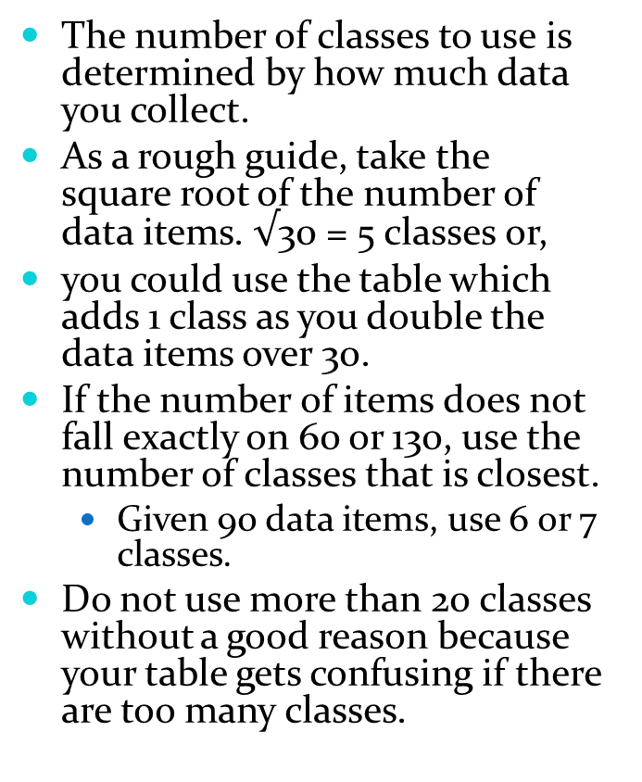
The number of classes to use is determined by how much data you collect.
As a rough guide, take the square root of the number of data items. $√$30 = 5 classes or,
you could use the table which adds 1 class as you double the data items over 30.
If the number of items does not fall exactly on 60 or 130, use the number of classes that is closest.
  Given 90 data items, use 6 or 7 classes.
Do not use more than 20 classes without a good reason because your table gets confusing if there are too many classes.
Items of Data | Number of classes
30 or less | 5
60 | 6
130 | 7
250 | 8
500 | 9
1000 | 10
2000 | 11
4000 | 12
8000 | 13
16,000 | 14

Slide 6
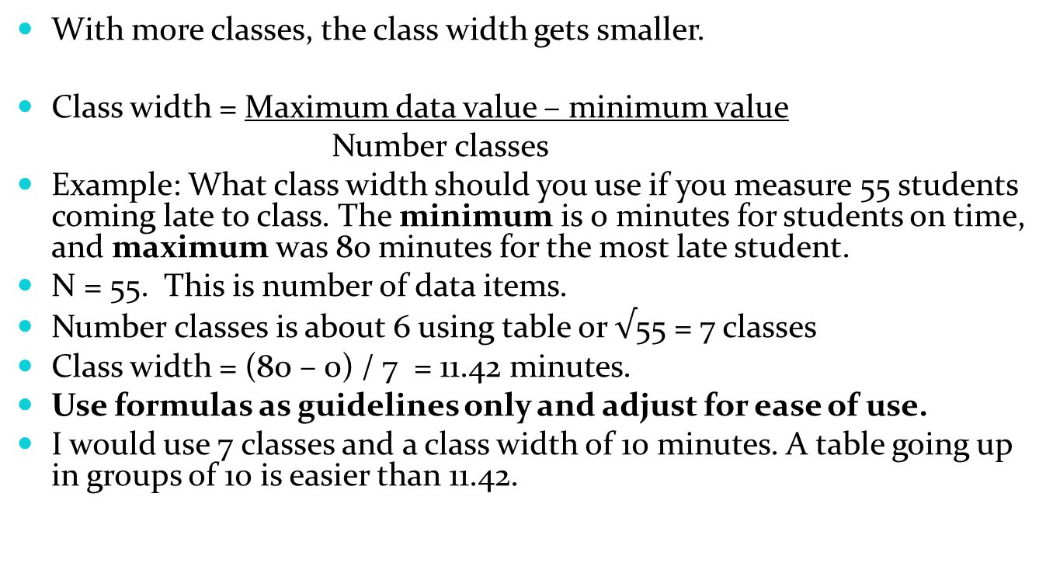
Class width
With more classes, the class width gets smaller.
Class width = Maximum data value – minimum value
Number classes
Example: What class width should you use if you measure 55 students coming late to class. The minimum is 0 minutes for students on time, and maximum was 80 minutes for the most late student.
N = 55. This is number of data items.
Number classes is about 6 using table or $√$55 = 7 classes
Class width = (80 – 0) / 7 = 11.42 minutes.
Use formulas as guidelines only and adjust for ease of use.
I would use 7 classes and a class width of 10 minutes. A table going up in groups of 10 is easier than 11.42.

Slide 7
Relative frequency
If 20 students got an A grade in the Summer and 30 got an A in Fall, are results improving?
  You cannot be sure; perhaps 200 students took the Summer course but 500 in the Fall.
  You can compare results if you look at the ratio of success by using relative frequencies.
    Summer relative frequency 20/200 = 10%
    Fall relative frequency 30/500 = 6%
    Results were worse in the Fall despite the bigger count of 30 !
  Relative frequency is frequency of class divided by total number of data items (ie. n is the sample size).

Slide 8
Grades | Frequency | Relative Frequency
80 to 100 | 5 | 5/109 =.046
70 to 79 | 20 | 20/109=.183
60 to 69 | 19 | 19/109=.174
55 to 59 | 16 | 16/109=.147
Less 55 | 49 | 49/109=.450
Total | 109 | 1
Depending on rounding, your relative frequency may sum to 99% or 101% rather than 100% (this is acceptable if it is due to rounding and not errors.)

Slide 9
Cumulative
A cumulative frequency adds up frequency counts
A cumulative relative frequency adds up relative frequency counts.
Do we add from the bottom up or the top down?
  Both are correct, it depends on what interests you.
For the grades example, do you care about how well students are doing or how badly?

Slide 10
Grades | Frequency | Relative Frequency | Cumulative Frequency (More-than) | Cumulative relative frequency
80 to 100 | 5 | .046 | 5 | 0.046
70 to 79 | 20 | .183 | 25 (5+20) | 0.229
60 to 69 | 19 | .174 | 44 (25+19) | 0.404
55 to 59 | 16 | .147 | 60 (44+16) | 0.550
Less 55 | 49 | .450 | 109 (60+49) | 1.000
Total | 109 | 1
Note: the addition is normally not shown (for instruction purposes only).

Slide 11
Cumulative Less-than or More-than
The frequencies in the previous slide were accumulated from the first category down.
  With this method, you can easily ask how many students got more-than a 70 or 60?
You can also accumulate from the bottom category up
  With this method, you can easily ask how many students got less than a 60 or 55?
Use the approach that suits the type of questions you want to answer.

Slide 12
Grades | Frequency | Relative Frequency | Cumulative Frequency (Less-than) | Cumulative relative frequency
80 to 100 | 5 | .046 | 109 | 1.00
70 to 79 | 20 | .183 | 104 | 0.954
60 to 69 | 19 | .174 | 84 | 0.771
55 to 59 | 16 | .147 | 65 | 0.596
Less 55 | 49 | .450 | 49 | .450
Total | 109 | 1
Note: the addition is normally not shown (for instruction purposes only).

Slide 13
Common graphical methods -1
Histogram
  An excellent first graphic to see if the shape looks symmetrical and bell-shaped indicating a normal distribution.
  Similar to a bar chart, but no gaps between the bars
  Usually quantitative, continuous data.
Scatter Diagram
  An excellent first graphic to test if two variables form a straight line relationship
  Is the relationship positive or negative? Is the slope strong?
  We study this graphic when we look at Correlation and Regression
Stem and Leaf
  Similar to a Histogram but shows the actual values within any class
Dot plot
  A quick method when your dataset is small

Slide 14
Graphic Methods - 2
Ogive
  Graph of the cumulative frequency
Bar chart
  Similar to a histogram, but has gaps or space between the bars
  Often used for nominal, qualitative data
Pareto
  Bar chart with the bars sorted from largest to smallest.
  80:20 rule – a few issues can cause most of the problems
Line chart
  Show trends over time
Pie chart
  Show proportions

Slide 15
Histogram
The following slide shows a histogram of 100 randomly generated numbers between 0 and 100
With 100 numbers, we should use 6 or 7 classes according to our table using the doubling method (called the K² method)
If we pretend these are grades, we can pick classes of 90 to 100 for A+, 80 to 89 for A, 75 to 79 for B+ and so on.
It is smart to have a More category and a Less category just in case for some unexpected reason you get a larger number than expected.
  For example, Student scores 100% plus a bonus of 1%.

Slide 16
Histogram n = 100

Slide 17
Creating a Histogram
  Excel: Click Data, Data Analysis, Histogram
Input Range: Enter cells containing data: A1:A15
Bin Range: Enter the upper value for each class you want
Grades | Classes
34 | 54
34 | 59
56 | 64
62 | 69
66 | 74
69 | 79
70 | 89
73
74
77
81
89
90
93
Classes | Frequency
54 | 2
59 | 1
64 | 1
69 | 2
74 | 3
79 | 1
89 | 2
More | 2

Slide 18
Click on the Label Histogram and write a better title
Right Click within one of the bars, click Format Data Series, Slide Gap Width to No Gap.

Slide 19
Stem and Leaf
When using classes, we can lose the details.
We know how many students got an A and fell into the first class, but we don’t know if they got 81% or 100%
Stem and Leaf shows the classes, each value in the class, and one can see the pattern of how data was distributed.
We use two groupings: stem and leaf.
Given this data: 73, 82, 85, 87, 91
  Stem is 7, leaf is 3 for 73
  Stem is 8, leaf is 2 for 82
  Stem is 8, leaf is 5 for 85
  Stem is 9, leaf is 1 for 91
Stem and Leaf
3
2 5 7
1

Slide 20
Stem and Leaf
Data .11, .14, .36, .37, .78
Make stem 1 decimal, leaf is 2nd decimal point
Stem and Leaf
  .1 1 4
  .3 6 7
  .7 8
Data $35135, $35216, $46254, $52046, 52,788, $87400
Make stem tens of thousands, decimal is in hundreds
Stem and Leaf
  35 1 2
  46 3
  52 0 8
  87 4

Slide 21
Dot Plot
Like Stem and Leaf, a dot plot is a quick way to see a pattern when your dataset is small
Excel has no Dot Plot chart so use another package or,
Draw a horizontal line in Word, fill in the scale, place dots where your data occurs. Stack dots if data values repeat, Copy and Paste into Excel.
Example: Number of pens or pencils per student.
  5, 9, 0, 2, 3, 7, 5
Scale evenly between 0 the minimum and 9 the maximum
0 1 2 3 4 5 6 7 8 9 10

Slide 22
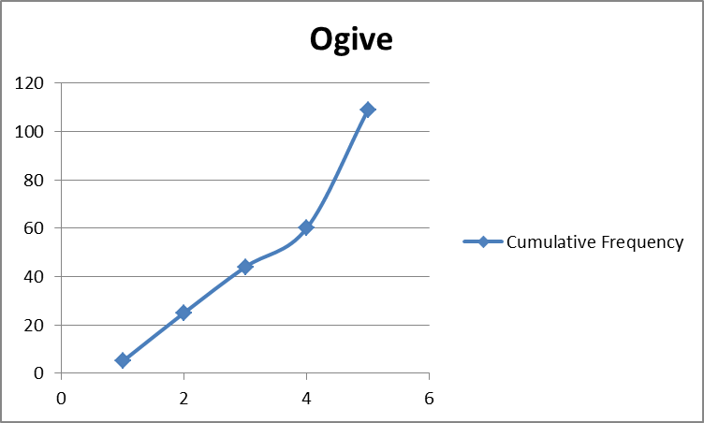
Ogive

Slide 23
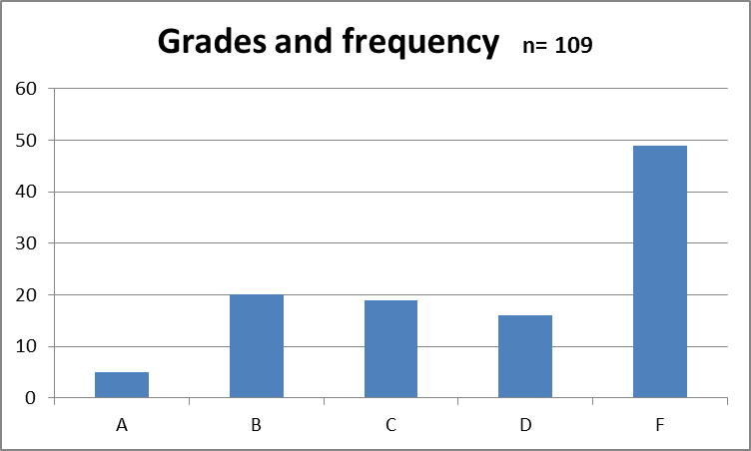
Bar Chart – showing a count
Click Insert, Chart, Column to create a bar chart

Slide 24
Pareto – sorted high to low
Pareto – is a sorted bar chart with the most important first
Sort data before you do the Insert, Chart, Column to display a bar chart as a Pareto chart.

Slide 25
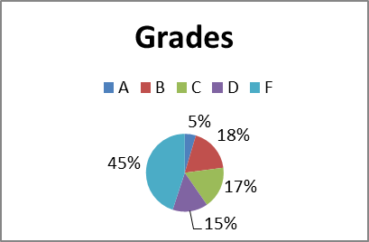
Pie chart – shows proportion
This is called a legend to show what each group represents

Slide 26
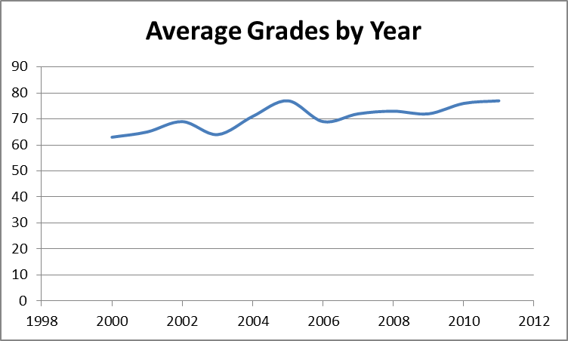
Line chart –can show trends

Slide 27
Graphics essentials
The graphs are over-simplified for instructional purposes.
Your graphics must have these essentials.
    Title, date, and your name
    Clear scale and label on both x and y axes
    Provide a legend if needed (eg. what are the pie segments?)
    You may create many graphs but show your client only the graphics needed to solve the problem.
Test your graphics.
  The best test is give your graphics to a stranger and provide no explanations. Let the graphic suffice.
  If the person understands the message in the graphic, then your labels, titles, and legends are clear enough.
  If they do not understand the message, clarify until they do.

Slide 28
How to use graphics
Do you see any trends, relationships, or patterns?
An excellent use of graphics is to compare.
  Is the new process, person, system, or method better?
  Show the before and after graphic.
When comparing,
  Has the center of the data changed?
  Is the data more variable in one graphic?
  Is the shape more symmetrical or skewed in one graphic

Slide 29
Real data
Be aware that real data can be messy.
  Missing numbers, numbers written incorrectly, etc.
  There are many methods to dealing with poor quality data that will likely be covered in any research course you take.
  Expect to spend as much time dealing with data quality as any other aspect of a project.
Special Note: the grade examples are hypothetical, the data was used to illustrate the ideas, not inform you about actual performance of any school or professor.

