Slide 1
Correlation and Regression
GrowingKnowing.com © 2011

Slide 2
Correlation and Regression
Correlation shows relationships between variables.
  This is important.
  All professionals want to understand relationships.
    If I double client calls, do I double my commissions?
    If I party twice a day, do I fail twice as quickly?
Regression provides equations, model, and predictions
  This is very important.
  Everyone wants to predict the future.
    IBM stock will go up 10% by next week.

Slide 3
Correlation
Relationships can be positive, negative, or none.
Positive relationship
  I study twice as long, and my grades go up
  Both variables increase together (study, grades)
Negative relationship
  I party twice as much, and my grades go down.
  One variable goes up (party) and the other goes down(grades)
No relationship
  I call Lady Gaga once, she does not return my call.
  I call her 3 times, then 20 times, she does not return my call.
  One variable is increasing, the other variable does not change.

Slide 4
Correlation and regression
Works with straight line graphs
  Does not have to be perfect, but somewhat straight
  Draw a scatter diagram to see if it looks straight?
If your data shows other shapes, we do NOT use correlation and regression
  You may be able to massage data to obtain a straight line such as taking the log or square root of one variable.
Simple regression has two variables
  Dependent variable
  Independent variable

Slide 5
Variables
The dependent variable (y) is the variable you want to predict, want to study, and care about most.
The independent variable (x) determines the dependent variable.
It can be difficult to know which is the dependent versus independent variable.
  Ask in both directions: is it more likely variable 1 determines variable 2 or does variable 2 determine variable 1 ?
  In business, the dependent variable is usually money since business cares more about money than anything or anyone
Will you be an boring because your parents are boring, or are your parents boring because of you? Which is dependent and which independent?
  Tip: if your results do not match the correct answer, try switching the dependent for independent variable?

Slide 6
Coefficient of correlation, r
The coefficient of correlation tells you the direction and strength of the relationship.
  R can be from -1.0 to +1.0
    0 means no relationship
    +1 or -1 is perfectly positive or negative respectively
    .5 is a moderate relationship
    The relationship becomes weaker as it approaches zero and stronger as it approaches 1
    Example: .25 is positive and weak, -.8 is negative and strong

Slide 7
Coefficient of determination, r²
Coefficient of determination and coefficient of correlation may have similar names, but they are very different.
R² shows how much the change in a dependent variable (y) is explained by a change in the independent variable (x).
Example: could be many reasons why you have good grades
  Study hard, come to class, practice problems, good teacher, …
  R² Explains how much of your grade (y) changes with the variable (x) used in your regression calculation versus a 1,000 other variables?
    Perhaps you used study-hard as variable x, so R² would tell you how much hard study changes your grade, versus coming-to-class or other variables.
    By comparing R² for different x variables, you can see which x variable has the largest impact on the y variable

Slide 8
Coefficient of correlation, r
  Strength and direction of relationship
Coefficient of determination, r²
  How much does x explain the change in y?
Be careful about saying x causes y
We see more babies when people buy more bananas, but that does not mean bananas cause babies.
  We may buy more bananas when we have more babies because babies have no teeth, and bananas are a soft food
    That does not mean babies cause bananas, seeds cause bananas.

Slide 9
Typical test questions.
Many test questions show material similar to Excel regression output and ask students to explain the concepts of correlation and regression.
We will focus on test questions.
You need no knowledge of how Excel works to understand the Excel output.

Slide 10
Excel output
** Note: focus on items highlighted in red
SUMMARY OUTPUT
Regression Statistics
Multiple R 0.939557535
R Square 0.882768362
Adjusted R Square 0.843691149
Standard Error 1.663329993
Observations 5
ANOVA
df SS MS F Significance F
Regression 1 62.5 62.5 22.59036145 0.01767543
Residual 3 8.3 2.766666667
Total 4 70.8
Coefficients Standard Error t Stat P-value
Intercept 6.3 1.744515214 3.611318461 0.036469725
Effort Level 2.5 0.525991128 4.752931879 0.01767543

Slide 11
Excel output
Excel Output
Multiple R 0.939557535
R Square 0.882768362
Coefficients Standard Error t Stat P-value
Intercept 6.3 1.744515 3.611318 0.0364697
Effort Level 2.5 0.525991 4.75293 0.01767543
Multiple R is the coefficient of correlation.
R Square is the coefficient of determination.
Intercept of 6.3 is ‘a’ in the regression equation ŷ = a + bx
Variable X, independent variable, is always on the line below Intercept
X is Effort level, 2.5 is ‘b’ the slope, in regression equation ŷ = a + bx

Slide 12
Coefficients Standard Error t Stat P-value
Intercept 6.3 1.744515 3.611318 0.0364697
Effort Level 2.5 0.525991 4.75293 0.01767543
Build the regression equation (also called the regression line)?
  ŷ = a + bx
  ŷ (Grades) = 6.3 + 2.5(Effort level)
If effort-level was 5, what would ŷ (grades) be?
  ŷ = 6.3 + 2.5(5) = 18.8
If effort-level was 10, what would ŷ (grades) be?
  ŷ = 6.3 + 2.5(10) = 31.3
Interpret the regression equation (also called regression line)?
  For every unit of effort-level increase, grades will improve 2.5 units.

Slide 13
Questions – x and y
What are x and y variables if we have a correlation of statistics grade for students and their average salary as employees?
  Importance. Students care more about salary than grades so dependent (y) is salary. Grade is x variable.
  Ask forward and backwards. Students who set high standards on grades could be employees that earn high salaries. A high salary later in life would not likely impact what grades you got early in school.
What are x and y variables? Profit made and color of product?
  Companies care more about profit, so profit is the y variable. Product color is x. Popular colors may improve sales but it is unlikely more profit changes product color .
What are dependent and independent variables? Teacher ability and student grades.
  We care most about grades, so grades is dependent on teacher ability. A teacher could more easily improve class grades than good grades could improve the teacher.

Slide 14
Multiple R -0.716738113 Classes-missed and grades.
R Square 0.513713523
Standard Error 3.895663034
Coefficients
Intercept 32.86666667
X Variable 1 -1.914285714
What is the dependent variable?
  Grades are dependent. Grades more important so likely the dependent.
What is the least squares regression line (also called regression equation)?
  Grades = 32.8 - 1.914(classes missed)
If a student missed 7 classes, what grade would they get?
  Grades = 32.8 -1.914(7) = 19.4
Interpret the slope?
  For each class missed, grades will fall 1.9 units
What is coefficient of correlation, interpret it?
  Multiple r is -72%, this is a strong negative correlation. As classes are missed goes up, the grades go down.
What is coefficient of determination, interpret it?
  51% of the change in grades is explained by classes missed, other variables explain the remaining 49% of grade performance.
What is standard error and interpret it?
  Prediction accuracy on grades will vary by +/- 3.896 units.

Slide 15
Multiple R 0.86 Number of practice problems and grades.
R Square 0.74
Standard Error 12.45
Coefficients
Intercept 45.81
X Variable 1 0.0387
What is the dependent variable?
  Grades are dependent. Grades more important so likely the dependent.
What is the regression equation?
  Grades = 45.81 + .0387(practice)
If a student practiced 800 problems, what grade would they get?
  Grades = 45.81 + .0387(800) = 76.77
Interpret the slope?
  For each practice problem, grades will increase .0387 units
What is coefficient of correlation, interpret it?
  Multiple r is 86%, this is a very strong positive correlation. As problems are practiced, the grades go up.
What is coefficient of determination, interpret it?
  74% of the change in grades is explained by practice problems, other variables explain the remaining 26% of grade performance.
What is standard error and interpret it?
  Prediction accuracy on grades will vary by +/- 12.45 units

Slide 16
Calculation example
Extremely unlikely you would need to do manual calculations for r on a test, perhaps as a take home assignment
The formulas are provided to understand what correlation is rather than how to calculate it.
How to generate Excel output is important if you take any research courses but won’t tested if you are learning statistics on a calculator

Slide 17
Calculation example
Number Practice Problems | Grades (in percent)
209 | 52
249 | 37
330 | 61
390 | 69
502 | 79
1501 | 100
Use this data to calculate r, r², intercept, slope, and standard error of the estimate

Slide 18
Calculation using Excel
Type the data into Excel
  Practice in column A, Grades in column B
On the menu, select Data, then Data Analysis
  If you don’t see Data Analysis on the extreme right of the menu ribbon, you need to see Excel Setup on the growingknowing.com website to Add-in Data Analysis.
Select Regression

Slide 19
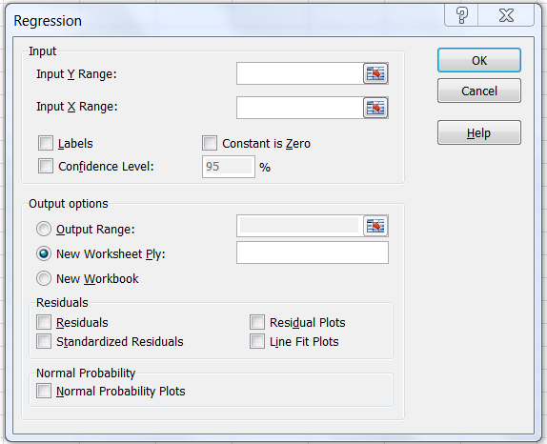
A1:A7
B1:B7
√

Slide 20
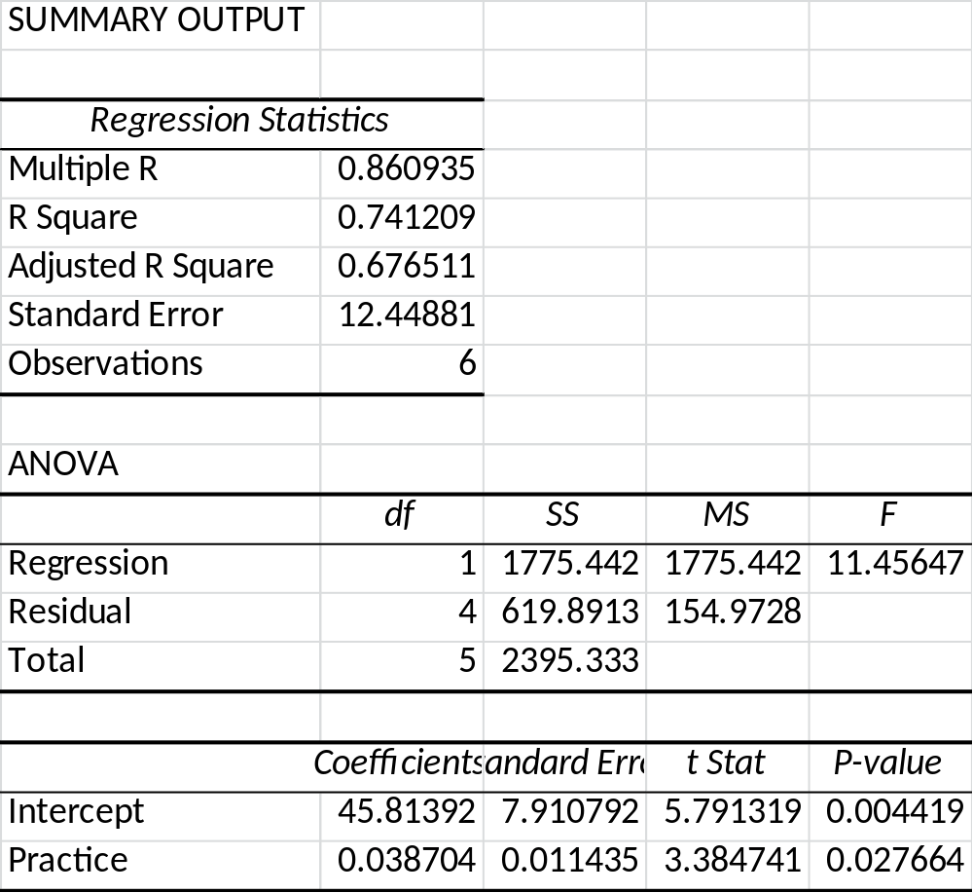

Slide 21
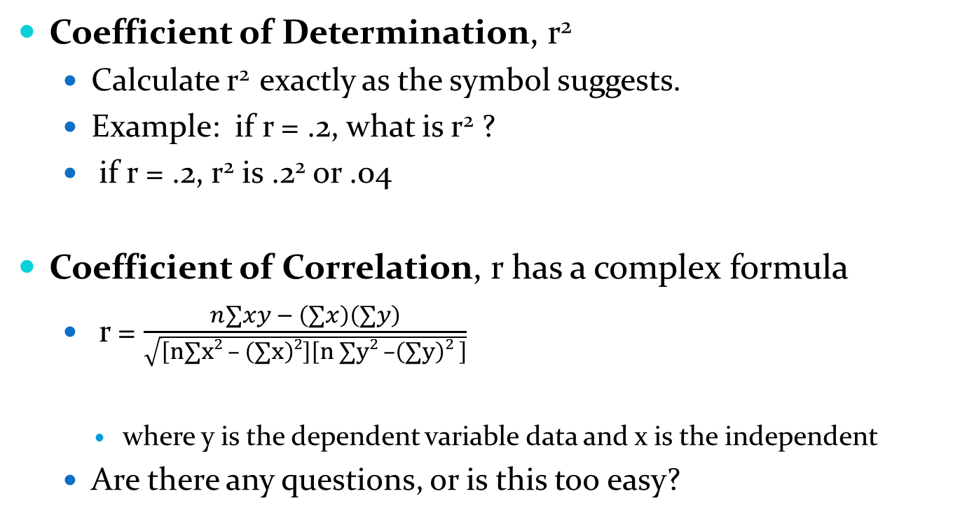
Formula
Coefficient of Determination, r²
  Calculate r² exactly as the symbol suggests.
  Example: if r = .2, what is r² ?
  if r = .2, r² is .2² or .04
Coefficient of Correlation, r has a complex formula
  r = $\frac{n∑xy − \left(∑x\right)\left(∑y\right)}{\sqrt{\left[n∑x2 – \left(∑x\right)2\right]\left[n ∑y2 –\left(∑y\right)2 \right]}}$
    where y is the dependent variable data and x is the independent
  Are there any questions, or is this too easy?

Slide 22
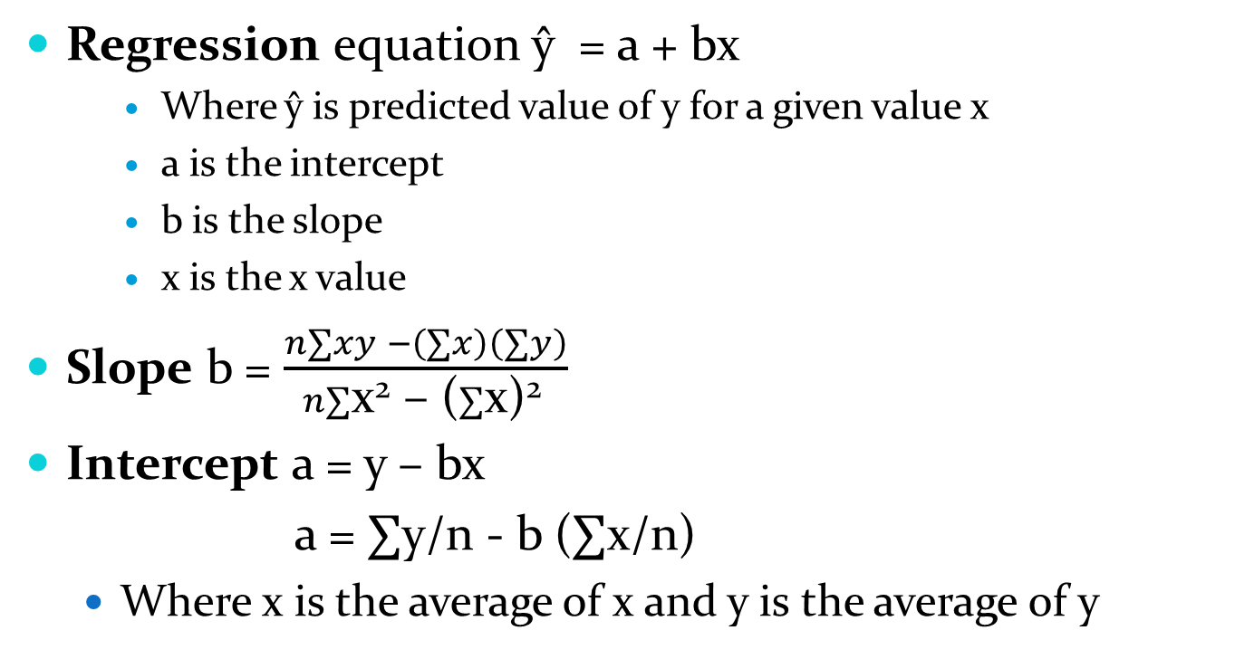
More formulas
Regression equation ŷ = a + bx
    Where ŷ is predicted value of y for a given value x
    a is the intercept
    b is the slope
    x is the x value
Slope b = $\frac{n∑xy −\left(∑x\right)\left(∑y\right)}{n∑\text{x}\text{2}\text{ – (}∑\text{x}\text{)2 }}$
Intercept a = y – bx
a = $∑$y/n - b ($∑$x/n)
  Where x is the average of x and y is the average of y

Slide 23
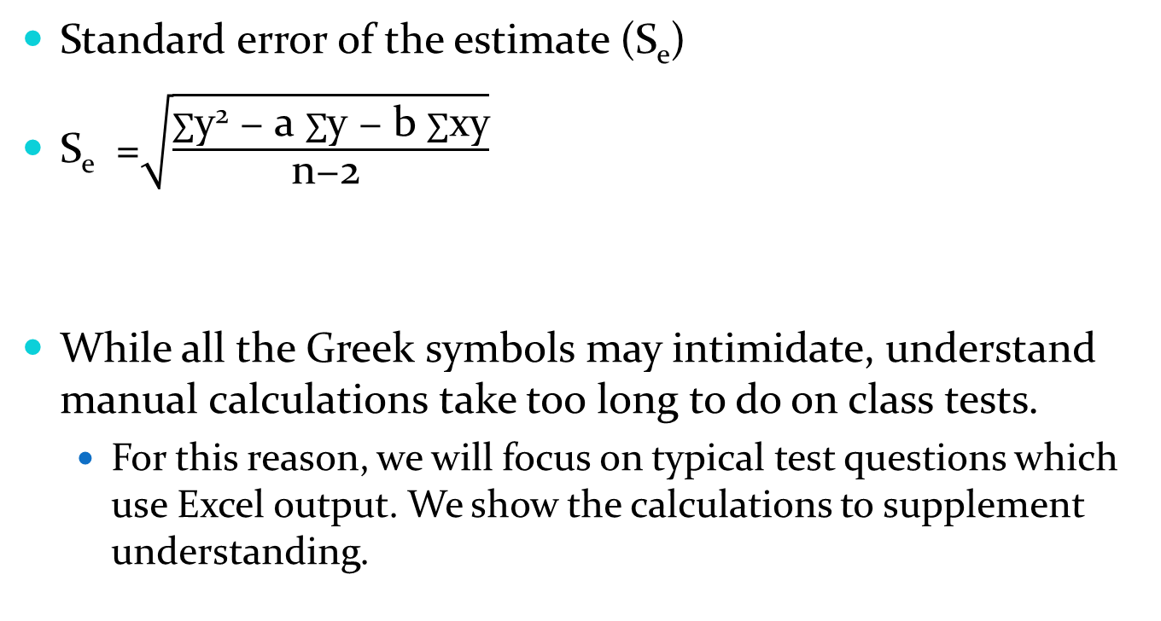
More formulas
Standard error of the estimate (S_{e})
S_{e} =$\sqrt{\frac{∑\text{y}\text{2}\text{ − }\text{a} ∑\text{y}\text{ − }\text{b} ∑\text{xy}}{\text{n}\text{−2 }}}$
While all the Greek symbols may intimidate, understand manual calculations take too long to do on class tests.
  For this reason, we will focus on typical test questions which use Excel output. We show the calculations to supplement understanding.

Slide 24
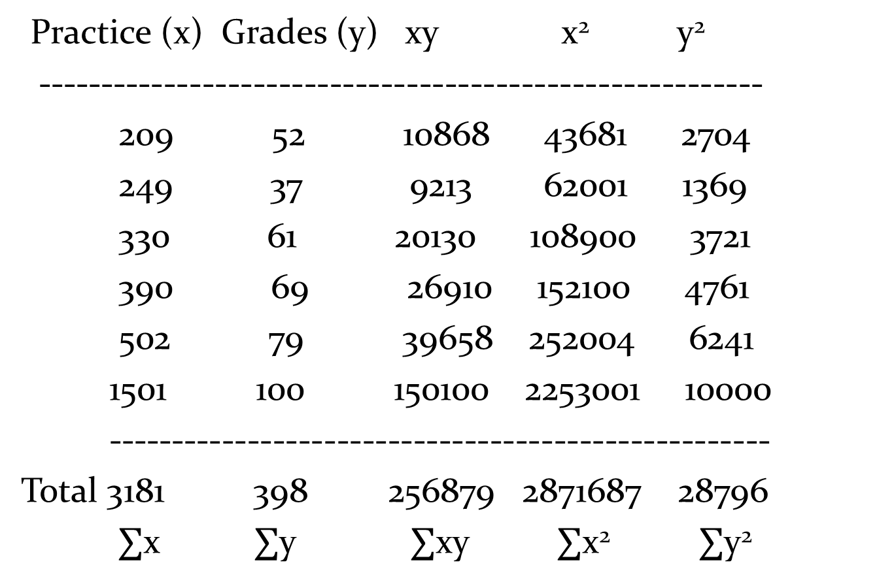
Practice (x) Grades (y) xy x² y²
---------------------------------------------------------
209 52 10868 43681 2704
249 37 9213 62001 1369
330 61 20130 108900 3721
390 69 26910 152100 4761
502 79 39658 252004 6241
1501 100 150100 2253001 10000
----------------------------------------------------
Total 3181 398 256879 2871687 28796
$∑$x $∑$y $∑$xy $∑$x² $∑$y²

Slide 25
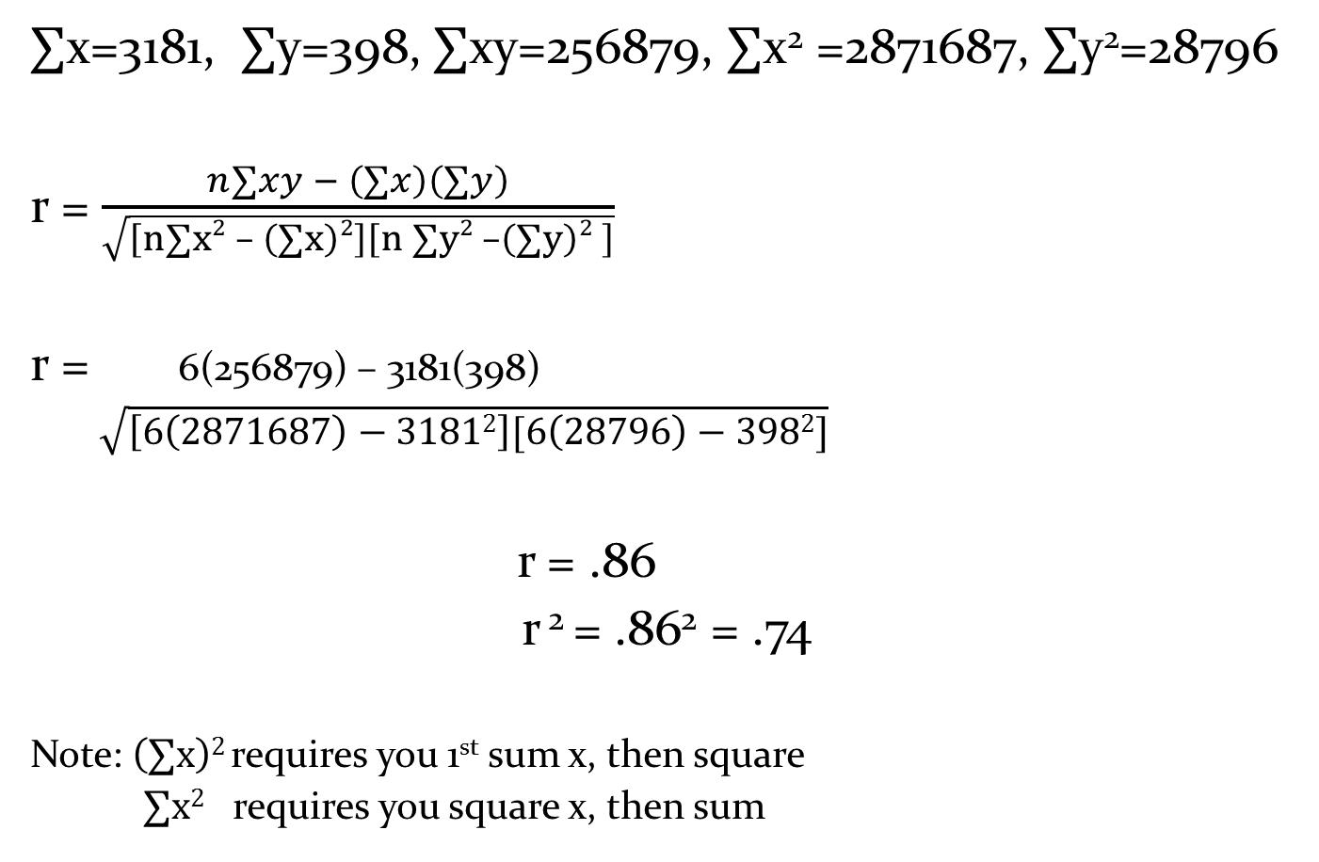
$∑$x=3181, $∑$y=398, $∑$xy=256879, $∑$x² =2871687, $∑$y²=28796
r = $\frac{n∑xy − \left(∑x\right)\left(∑y\right)}{\sqrt{\left[n∑x2 – \left(∑x\right)2\right]\left[n ∑y2 –\left(∑y\right)2 \right]}}$
r = 6(256879) – 3181(398)
$\sqrt{\left[6\left(2871687\right)−31812\right][6\left(28796\right)−3982]}$
r = .86
r ² = .86² = .74
Note: $\left(∑x\right)2$requires you 1st sum x, then square
$∑x2$ requires you square x, then sum

Slide 26
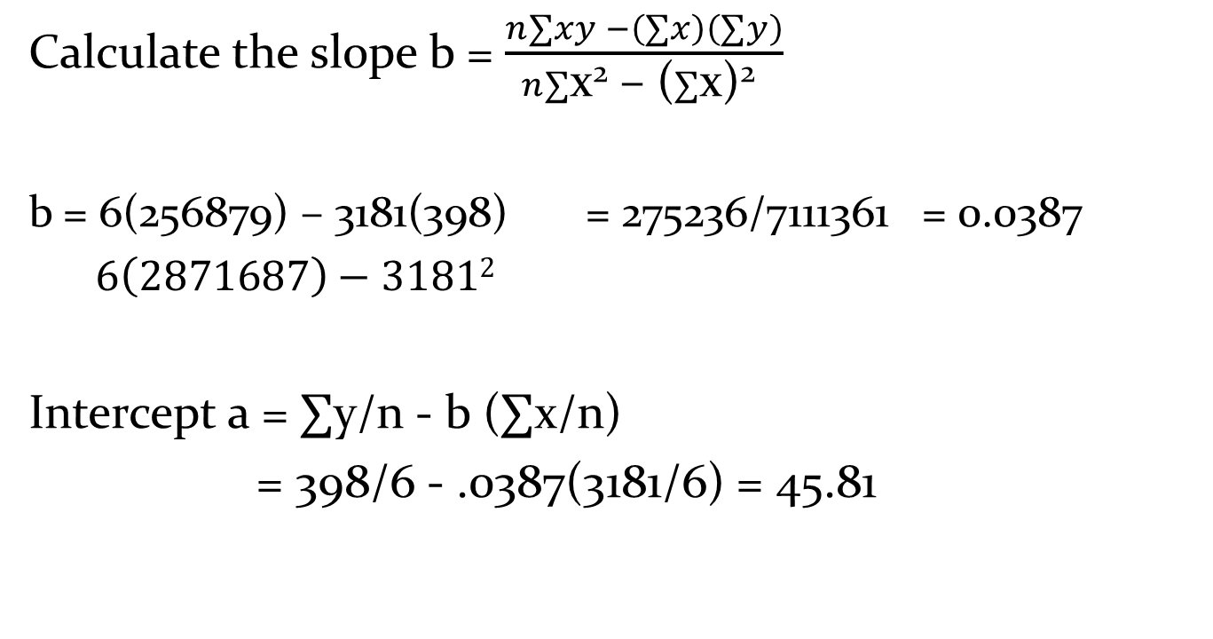
Slope and Intercept
Calculate the slope b = $\frac{n∑xy −\left(∑x\right)\left(∑y\right)}{n∑\text{x}\text{2}\text{ – (}∑\text{x}\text{)2 }}$
b = 6(256879) – 3181(398) = 275236/7111361 = 0.0387
$6\left(2871687\right)−31812$
Intercept a = $∑$y/n - b ($∑$x/n)
= 398/6 - .0387(3181/6) = 45.81

Slide 27
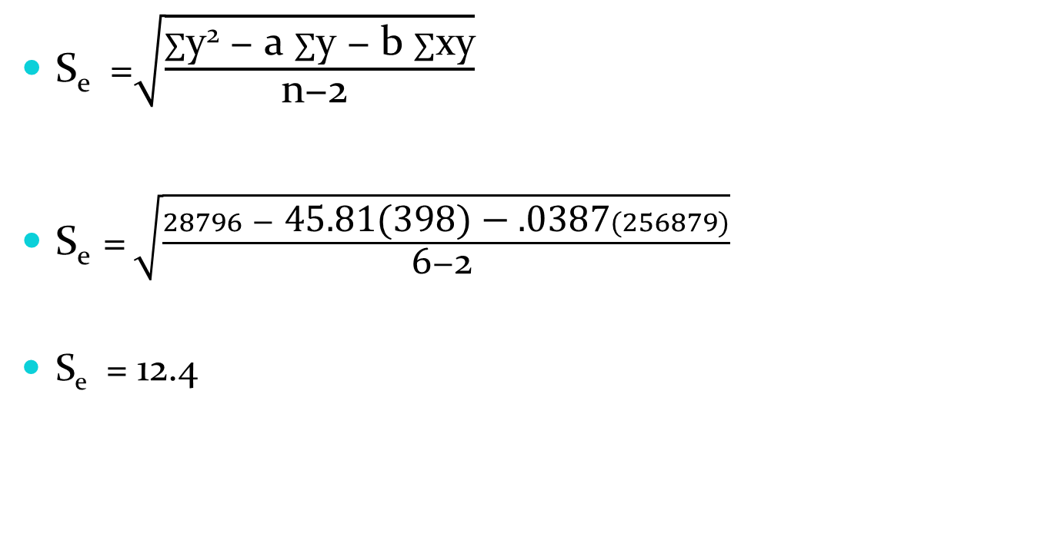
Error of the estimate
S_{e} =$\sqrt{\frac{∑\text{y}\text{2}\text{ − }\text{a} ∑\text{y}\text{ − }\text{b} ∑\text{xy}}{\text{n}\text{−2 }}}$
S_{e} = $\sqrt{\frac{28796\text{ − }\text{45.81(398)}\text{ − }\text{.0387}(256879)}{\text{6}\text{−2 }}}$
S_{e} = 12.4

Slide 28
Last lecture
May probabilities always smile on your choices
May your hypothesis tests always reject the null
May your relationships and their correlations be positive
May your regression equations predict a great future life

Slide 29
Go to website, do the Correlation Regression problems

