Slide 1
Confidence Intervals
GrowingKnowing.com © 2011

Slide 2
Estimates
We are often asked to predict the future!
  When will you complete your team project?
  When will you make your first million dollars?
  When will you clean the dishes?
You can give a point estimate or interval estimate
    Point estimate: Project will be done Friday at 2
    Interval estimate: Project will be done this week (7 day range)
The smart answer is the interval estimate
  Because it includes a range to allow for variability
    Life has surprises, illness, accidents…. standard deviations
  For a point estimate, 2.01 pm, if you’re late, … trouble!

Slide 3
Confidence Level
Whatever promise you make
  to your boss, team, … interval or point estimate
If they are smart, their next question will be
HOW CONFIDENT ARE YOU?
If you say 99% confident level, they won’t worry
If you say 20% confident , …
  Trust declines, not so good, …. ‘we have to talk?’

Slide 4
Confidence Interval vs. Confidence Level
Confidence Interval
  Range: I’ll clean the dishes between Monday at 2pm and next September.
    Confidence interval is a range of values that is expected to include an unknown population parameter based on your sample.
    Note: You have an upper and lower answer
Confidence Level
  Level : I ‘m 99% confident dishes will be clean in this interval.
    Confidence level is how likely the value will fall within your confidence interval.
Confidence level and interval are different.
  Interval is a range. Confidence level is a percentage.

Slide 5
Some important words
Level of significance
Alpha
Confidence Level
These words are all talking about the same idea.
Alpha is level of significance.
  Alpha just a shorter word for level of significance.
  Alpha is the complement of Confidence Level.

Slide 6
Alpha = 1 – confidence level
Confidence = 1 - alpha
  What is alpha if Confidence level is 99%,
    Alpha = 1 - .99 = .01
  What is alpha if Confidence level is 95%,
    Alpha = 1 - .95 = .05
  What is the confidence level if Alpha is .10,
    then Confidence Level is 1 - .1 = 90%
  Alpha is 5%, what is the level of significance?
    .05 or 5%. Alpha is the level of significance.
  Level of significance is 5%, what is confidence level?
    Confidence level = 1 – level of significance = 95%

Slide 7


Important calculations
Standard Error for Means
  = Standard deviation divided by square root of sample size (n)
  Standard Error =
Margin of Error (E)
  = z multiplied by standard error (σ_{x})
  Margin of Error =
Confidence Interval
  Upper interval = mean + margin of error = x̄ + zσ_{x̄}
  Lower interval = mean – margin of error = x̄ - zσ_{x̄}

Slide 8
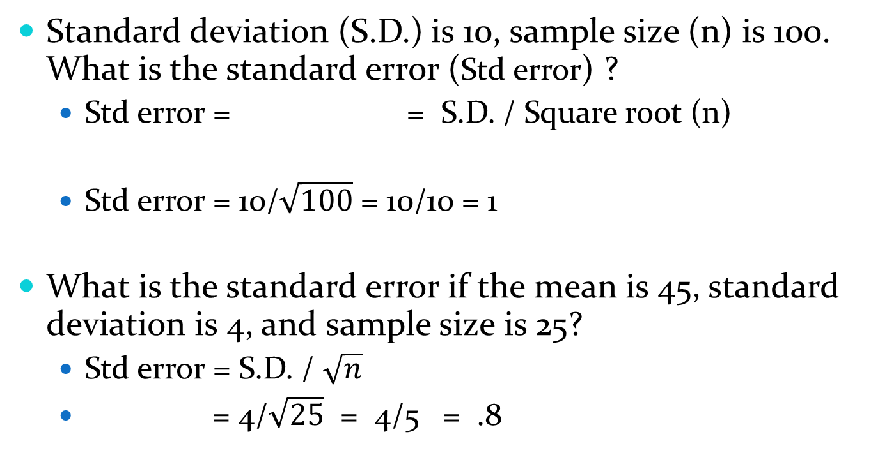
Test
Standard deviation (S.D.) is 10, sample size (n) is 100. What is the standard error (Std error) ?
  Std error = = S.D. / Square root (n)
  Std error = 10/$\sqrt{100}$ = 10/10 = 1
What is the standard error if the mean is 45, standard deviation is 4, and sample size is 25?
  Std error = S.D. / $\sqrt{n}$
  = 4/$\sqrt{25}$ = 4/5 = .8

Slide 9
Confidence
Confidence is a 2 tail calculation (upper and lower values)
You can make an error by predicting too low or too high.
  2 ways to make a mistake.
Example: you predict the Maple Leafs will lose 150 to 200 games
  You could be too low, they lose the next 350 games.
  You could be too high, they lose only the next 144 games.
  Either too high or too low indicate your interval was not correct.
A realistic example, you want to sell your stock at just the right price. Your confidence level says sell between 101 and 109 dollars.
  If you are wrong and it goes higher, you lose profits.
  If are wrong and it never reaches 101, you lose opportunity.
  Two tail calculation.

Slide 10
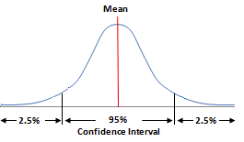
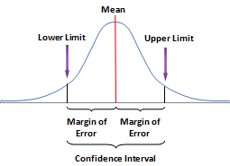
Error is too high or too low
For 95% confidence, you expect 95% of your samples will fall between lower and upper interval values.
Alpha is 5%, so 5% the samples will be outside the interval.
5% divide by 2, so 2.5% of samples will be too high, and 2.5% will be too low.

Slide 11
Calculating z
Example: confidence level is 95%
  Probability is (confidence level + alpha / 2)
  Probability is (.95 + .05/2 ) = .9750
    z value for probability .9750 = 1.96
  z = 1.96
Link to Normal table
  www.growingknowing.com/GKStatsBookNormalTable2.html

Slide 12
Calculating z
Example: confidence level is 98%
  Probability (confidence level + alpha /2)
    Probability = .98 + .02/2 = .99
  z value for probability .9900 = 2.33

Slide 13
What is the right amount of confidence?
Most studies use 90%, 95%, and 99% confidence levels
  How do you decide which level to pick?
For $1 million dollars, this is an important decision, so be sure to set a 99% confidence level.
For a $1 bet, not so important, 90% confidence is fine.
To speed up your tests and reduce errors, memorize the popular confidence levels.
  90% confidence z = 1.64
  95% confidence z = 1.96
  99% confidence z = 2.58

Slide 14
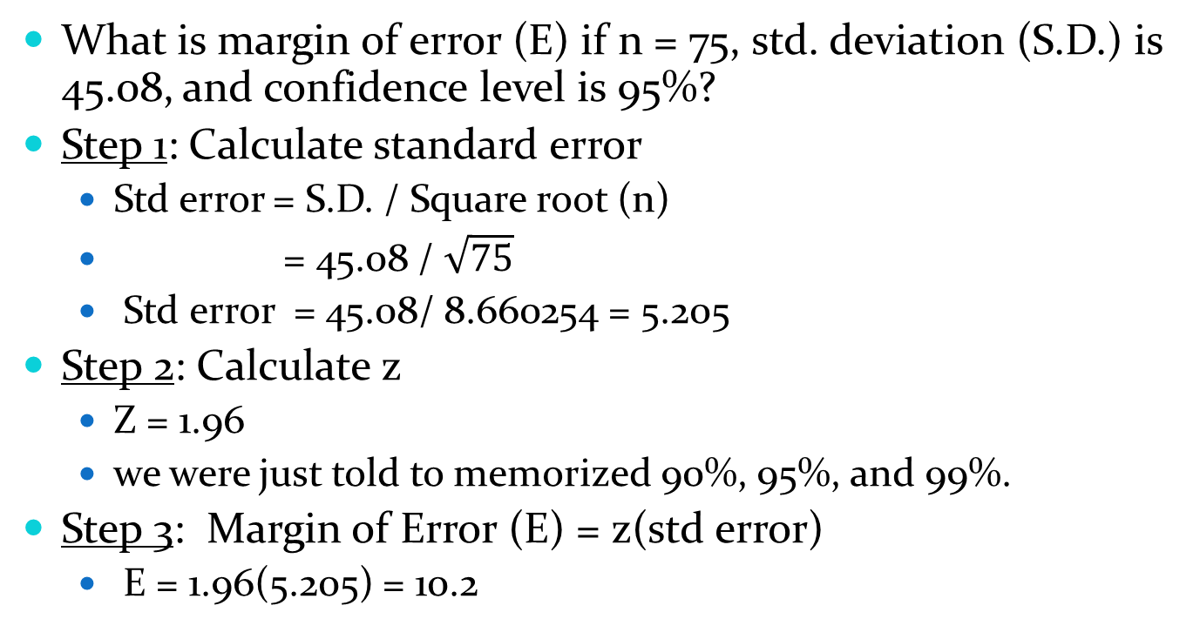
Calculating Margin of Error (E)
What is margin of error (E) if n = 75, std. deviation (S.D.) is 45.08, and confidence level is 95%?
Step 1: Calculate standard error
  Std error = S.D. / Square root (n)
  = 45.08 / $\sqrt{75}$
  Std error = 45.08/ 8.660254 = 5.205
Step 2: Calculate z
  Z = 1.96
  we were just told to memorized 90%, 95%, and 99%.
Step 3: Margin of Error (E) = z(std error)
  E = 1.96(5.205) = 10.2

Slide 15
Confidence intervals
Step 4: Calculate confidence intervals
If the margin of error (E) is 10.2 and mean is 92, what are the confidence intervals?
  Upper interval = mean + E
  Lower interval = mean – E
Upper is 92 + 10.2 = 102.2
Lower is 92 – 10.2 = 81.8

Slide 16
Example
What is the Confidence Interval where n = 75, mean = 61, S.D. = 8.54, and confidence level =96%?
Step 1: Std Error = S.D./ square root (n)
Step 2: Find z
Step 3: Margin of error E = z(std error)
Step 4: Confidence intervals Mean +/- E

Slide 17
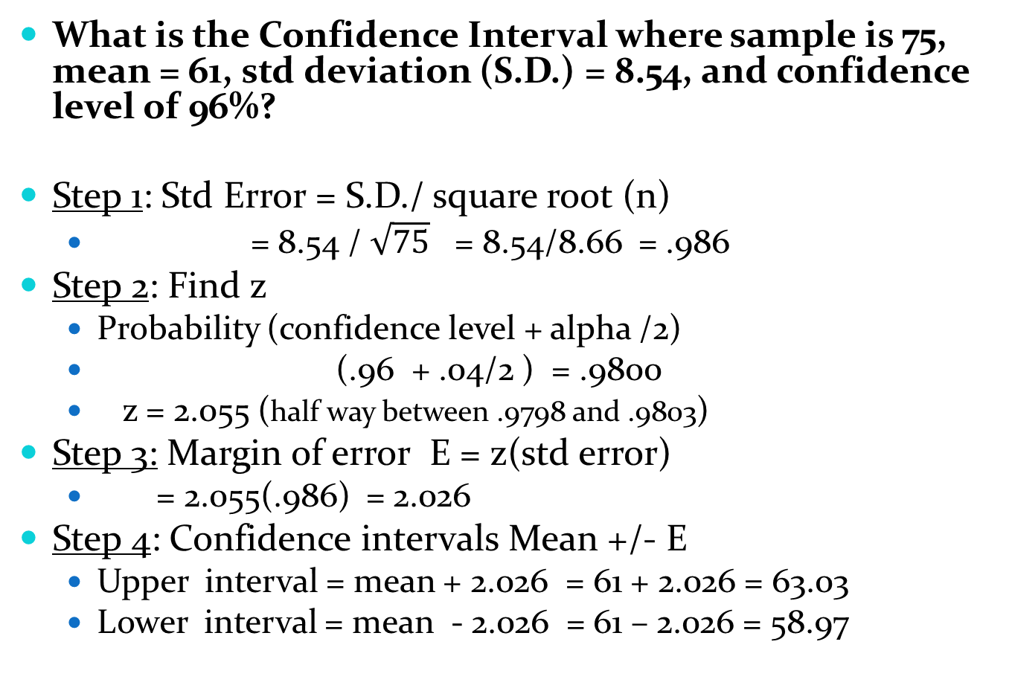
What is the Confidence Interval where sample is 75, mean = 61, std deviation (S.D.) = 8.54, and confidence level of 96%?
Step 1: Std Error = S.D./ square root (n)
  = 8.54 / $\sqrt{75}$ = 8.54/8.66 = .986
Step 2: Find z
  Probability (confidence level + alpha /2)
  (.96 + .04/2 ) = .9800
  z = 2.055 (half way between .9798 and .9803)
Step 3: Margin of error E = z(std error)
  = 2.055(.986) = 2.026
Step 4: Confidence intervals Mean +/- E
  Upper interval = mean + 2.026 = 61 + 2.026 = 63.03
  Lower interval = mean - 2.026 = 61 – 2.026 = 58.97

Slide 18
Practice
Go to website and practice Confidence Interval
  Difficulty level 1 only
  To complete level 2, you need the proportion lesson

Slide 19
Small Samples Confidence
If your sample size (n) is less than 30, you cannot use the normal distribution table (see Central Limit Theory)
For small samples, use the Student t table
  t table is more robust, works well with data that is not perfectly normal.
The t table uses alpha and degrees of freedom (df).
degrees of freedom (df) = n - 1
The only difference in calculating small sample confidence and large samples is the t table, all other calculations and steps are the same.

Slide 20
Degrees of freedom
Put your hand on your head, now take a sample of 21, and a mean of 22, and calculate the degrees of freedom?
  df = n – 1
  df = 21 – 1 = 20
Taxes, work, bosses, parents, …. is freedom an illusion?

Slide 21
Using the t table
Calculate t for 90% confidence level using sample 16?
  Degrees of freedom = n – 1
    df = 16 – 1 = 15
  Alpha = 1 – confidence level
  alpha = 1 - .9 = .10
Lookup 2 tail t table for .10 and df = 15, t = 1.753
  http://www.growingknowing.com/GKStatsBook.php?topic=StudentTTable

Slide 22
Example
What is the Confidence Interval where n = 16, mean = 53, S.D. = 14.84, and confidence level =90%?
Step 1: Std Error = S.D./ square root (n)
Step 2: Calculate t
Step 3: Margin of error E = t(std error)
Step 4: Confidence intervals Mean +/- E

Slide 23
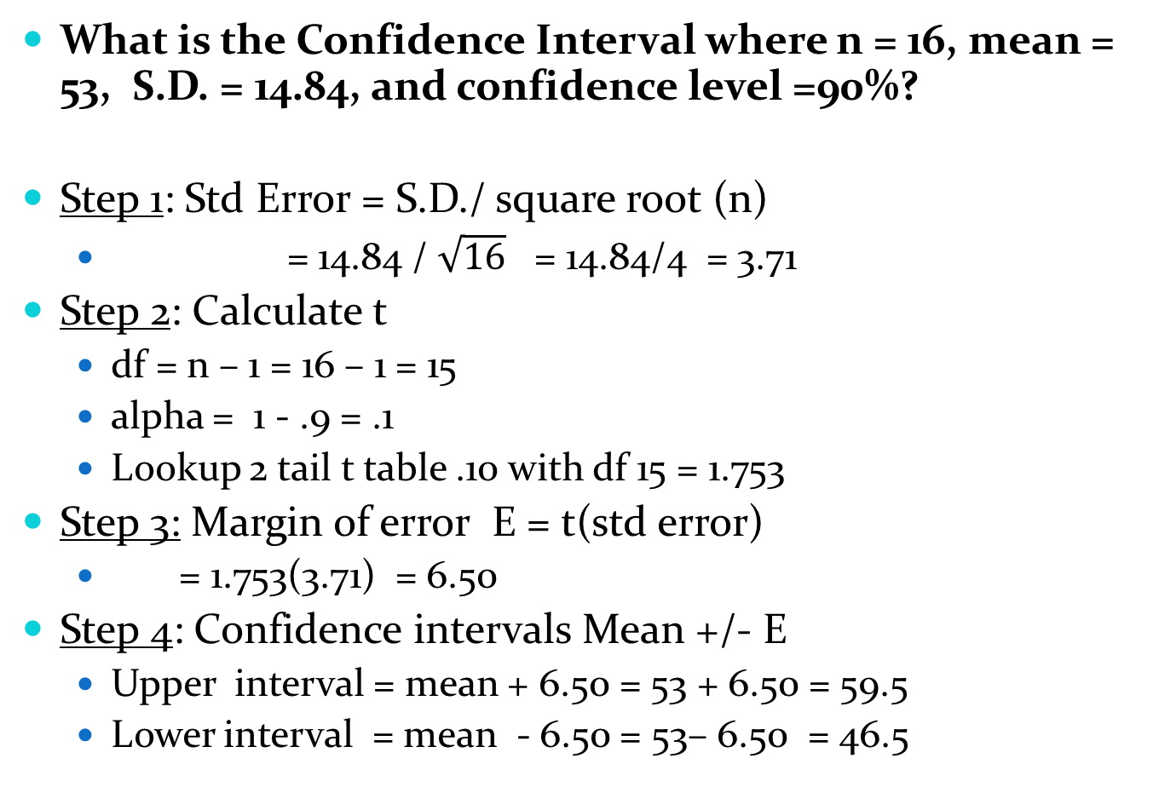
What is the Confidence Interval where n = 16, mean = 53, S.D. = 14.84, and confidence level =90%?
Step 1: Std Error = S.D./ square root (n)
  = 14.84 / $\sqrt{16}$ = 14.84/4 = 3.71
Step 2: Calculate t
  df = n – 1 = 16 – 1 = 15
  alpha = 1 - .9 = .1
  Lookup 2 tail t table .10 with df 15 = 1.753
Step 3: Margin of error E = t(std error)
  = 1.753(3.71) = 6.50
Step 4: Confidence intervals Mean +/- E
  Upper interval = mean + 6.50 = 53 + 6.50 = 59.5
  Lower interval = mean - 6.50 = 53– 6.50 = 46.5

Slide 24
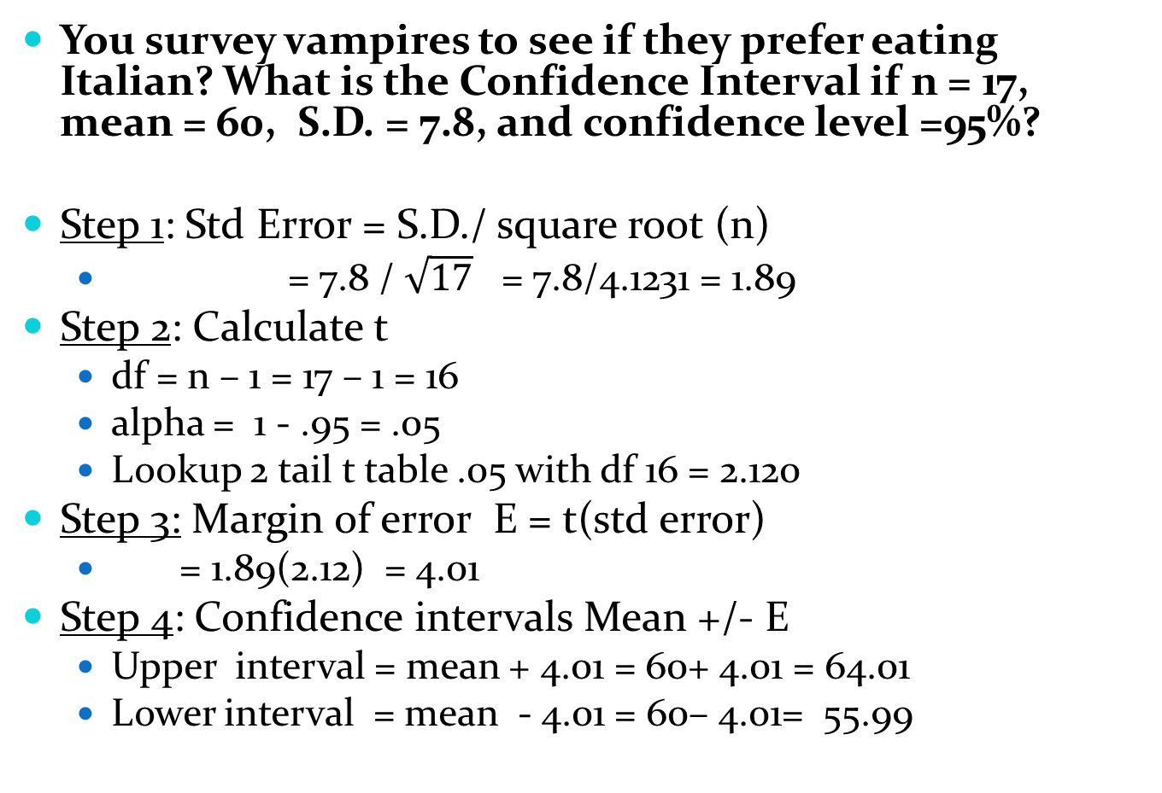
You survey vampires to see if they prefer eating Italian? What is the Confidence Interval if n = 17, mean = 60, S.D. = 7.8, and confidence level =95%?
Step 1: Std Error = S.D./ square root (n)
  = 7.8 / $\sqrt{17}$ = 7.8/4.1231 = 1.89
Step 2: Calculate t
  df = n – 1 = 17 – 1 = 16
  alpha = 1 - .95 = .05
  Lookup 2 tail t table .05 with df 16 = 2.120
Step 3: Margin of error E = t(std error)
  = 1.89(2.12) = 4.01
Step 4: Confidence intervals Mean +/- E
  Upper interval = mean + 4.01 = 60+ 4.01 = 64.01
  Lower interval = mean - 4.01 = 60– 4.01= 55.99

Slide 25
Confidence levels
People like a high confidence level but small interval.
  I’m 95% confident I’ll deliver between Monday and August. Will you be home?
It is easy to have small interval with small confidence level
  I’ll deliver Friday 12.00 to 12:05 am, I’m 50% confident.
If you increase the confidence level, the interval gets larger
How can you get both high confidence and small intervals?
Look at the formula, best way is increase the sample size.

Slide 26
Practise
Go to the website, do Small Sample Confidence.

