Slide 1
Central Limit
Manual
GrowingKnowing.com © 2011

Slide 2
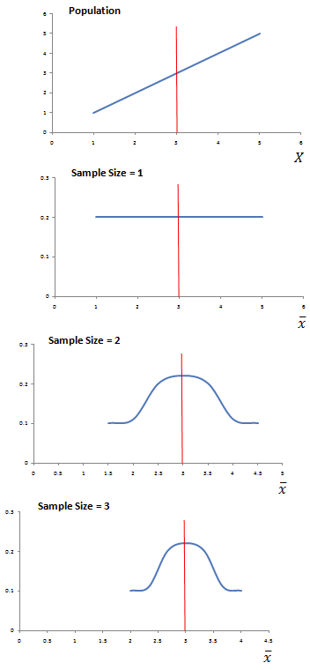
Central limit theory
Whether your distribution is a straight line, sine wave, flat line, or odd distribution pattern,
  as you take many samples of increasing size of 30 or more,
  the distribution of the sample means becomes a normal distribution.
Basically, we can use normal distribution methods on non-normal data if we use sample sizes of 30+.

Slide 3


Standard Error of the Mean
If a sample size is provided, use the standard error instead of standard deviation by dividing the standard deviation by the square root of n.
Standard Error =
Z score =
σ_{x̄} is the standard deviation of the means of many samples and is called the "standard error of the mean".
σ is standard deviation, n is the sample size.

Slide 4
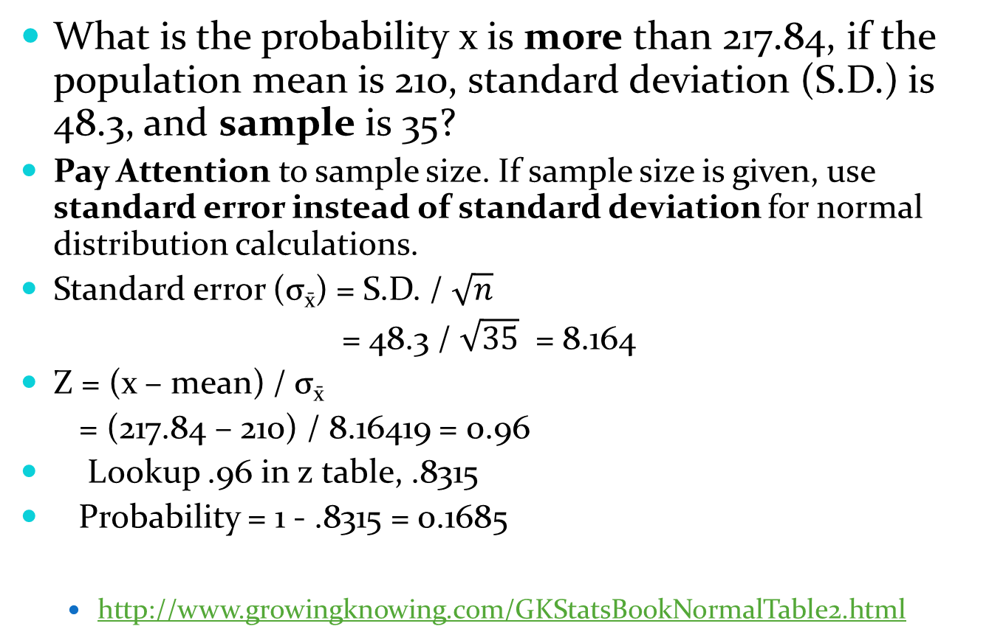
What is the probability x is more than 217.84, if the population mean is 210, standard deviation (S.D.) is 48.3, and sample is 35?
Pay Attention to sample size. If sample size is given, use standard error instead of standard deviation for normal distribution calculations.
Standard error (σ_{x̄}) = S.D. / $\sqrt{n}$
= 48.3 / $\sqrt{35}$ = 8.164
Z = (x – mean) / σ_{x̄}
= (217.84 – 210) / 8.16419 = 0.96
Lookup .96 in z table, .8315
Probability = 1 - .8315 = 0.1685
  http://www.growingknowing.com/GKStatsBookNormalTable2.html

Slide 5
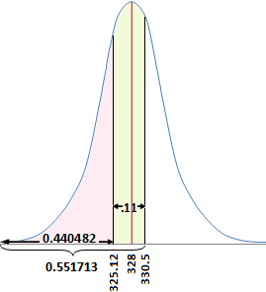
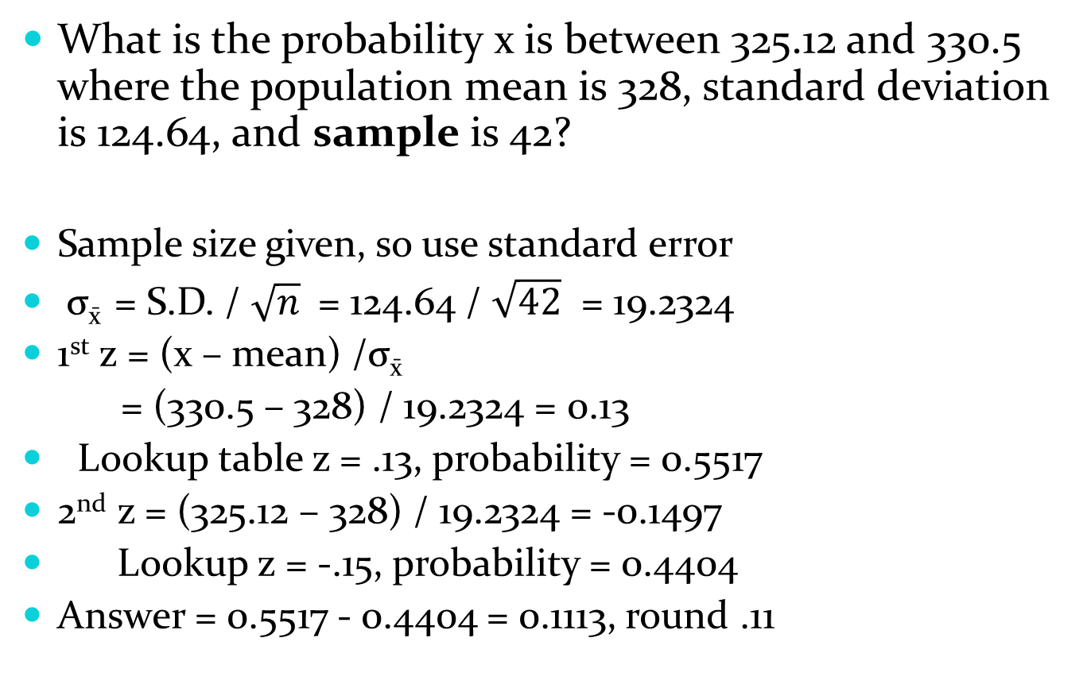
What is the probability x is between 325.12 and 330.5 where the population mean is 328, standard deviation is 124.64, and sample is 42?
Sample size given, so use standard error
σ_{x̄} = S.D. / $\sqrt{n}$ = 124.64 / $\sqrt{42}$ = 19.2324
1st z = (x – mean) /σ_{x̄}
= (330.5 – 328) / 19.2324 = 0.13
Lookup table z = .13, probability = 0.5517
2nd z = (325.12 – 328) / 19.2324 = -0.1497
Lookup z = -.15, probability = 0.4404
Answer = 0.5517 - 0.4404 = 0.1113, round .11

Slide 6
Practise
Go to the website, do Central Limit Theory questions.

