Slide 1
Central Limit
Excel
GrowingKnowing.com © 2020

Slide 2
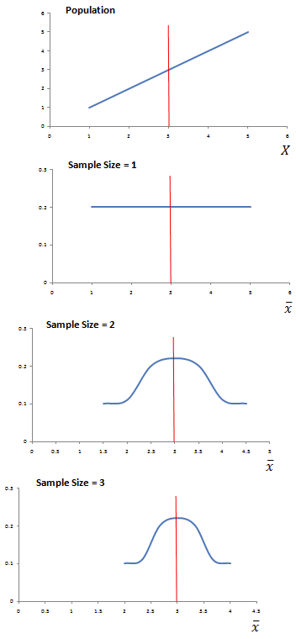
Central limit theory
Whether your distribution is a straight line, sine wave, flat line, or odd distribution pattern,
  as you take many samples of increasing size,
  the distribution of the sample means becomes a normal distribution,
  as the sample size approaches 30 or more.
In simple terms, we can use normal distribution methods on non-normal data, provided we take many sample sizes of 30+.

Slide 3


Standard Error of the Mean
If a sample size is provided, use the standard error instead of standard deviation by dividing the standard deviation by the square root of n.
Standard Error =
Z score =
σ_{x̄} is the standard deviation of the means of many samples and is called the "standard error of the mean".
σ is standard deviation, n is the sample size.

Slide 4
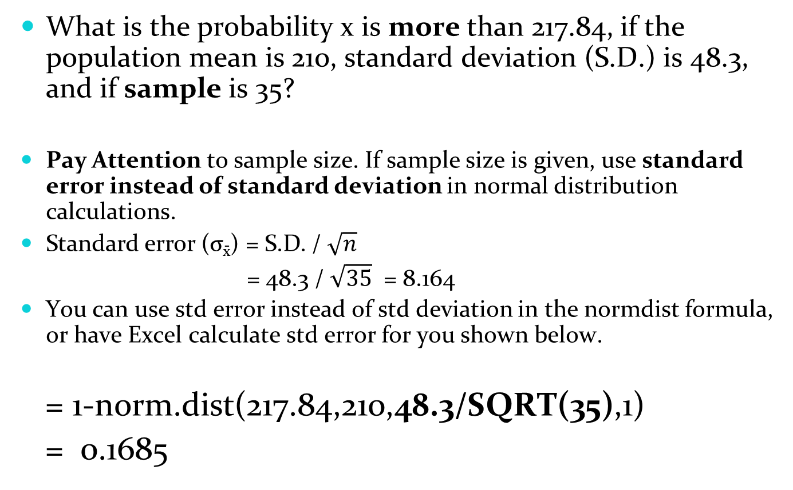
What is the probability x is more than 217.84, if the population mean is 210, standard deviation (S.D.) is 48.3, and if sample is 35?
Pay Attention to sample size. If sample size is given, use standard error instead of standard deviation in normal distribution calculations.
Standard error (σ_{x̄}) = S.D. / $\sqrt{n}$
= 48.3 / $\sqrt{35}$ = 8.164
You can use std error instead of std deviation in the normdist formula, or have Excel calculate std error for you shown below.
= 1-norm.dist(217.84,210,48.3/SQRT(35),1)
= 0.1685

Slide 5
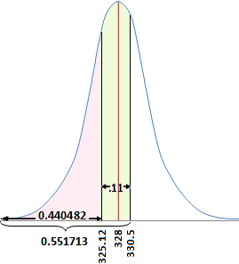
What is the probability x is between 325.12 and 330.5 where the population mean is 328, standard deviation is 124.64, and sample is 42?
Sample size given, so use standard error
instead of standard deviation.
X1 =norm.dist(330.5,328,124.64/SQRT(42),1) = 0.551713 X2 =norm.dist(325.5,328,124.64/SQRT(42),1) = 0.440482
Answer = X1 – X2 = 0.551713 – 0.44048 = 0.11123, round .11

Slide 6
Practise
Go to the website, do Central Limit Theory questions.

